Slide 1
Emerging Practices in Foresight
Andy Hines
APF Pro Development, Houston April 22, 2022

Slide 2
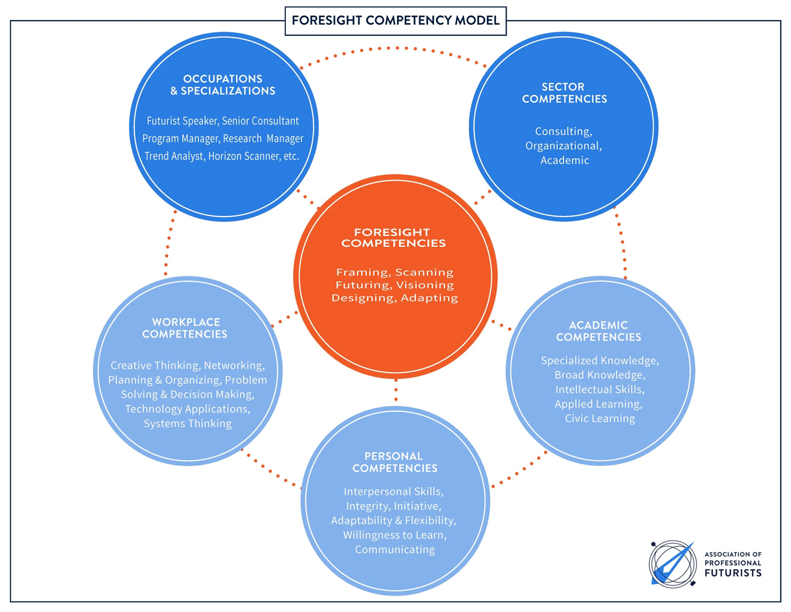
Competency Model
1
2
3
4

Slide 3
APF Six Competencies
Framing | Scoping the project, defining the focal issue and current conditions
Scanning | Exploring signals of change or indicators of the futures
Futuring | Identifying a baseline and alternative futures
Visioning | Exploring implications of the futures
Designing | Crafting options and an integrated strategic approach
Adapting | Communicating the response, ongoing monitoring, and implementation

Slide 4
How Existing “Approaches” Fit
 | Woodgate Future Fabbing | Micic Eltville Model | GBN 2x2 | Voros /AFI Generic Process | Framework Foresight
Framing | FutureFraming |  | Focal issues & interviewing |  | Domain definition
Scanning | FuturePulsing | Future Radar | Driving Forces, uncertainties, predetermineds | Inputs | Current Assessment/ Scanning
Futuring | FutureMapping; FutureScaping; | Probable future Possible future Unexpected future | Scenario logics | Analysis | Baseline & Alternative Futures forecasts
Visioning | FutureTuning | Desired future (vision) | Implications | Interpretation Prospection | Preferred Future Implications Analysis
Designing | FutureFabbing | Created future (strategies) | Options | Outputs Strategy | Futures to Plans (Issues and Opportunities)
Adapting | FutureFabbing |  | Early Indicators |  | Indicators

Slide 5
Various methods and technique for carrying foresight competencies
Competency | Methods/techniques
Framing | Cynefin, domain mapping, organizational foresight audit, integral futures
Scanning | Environmental scanning, content analysis, data mining, monitoring, stakeholder analysis, trend identification
Futuring | CLA, cross impact matrix, Delphi, emerging issue analysis, games/simulations, integral futures, personas, predictive markets, scenarios (2x2, archetypes, backcasting, incasting, etc.) morphological analysis, presencing statistical modeling (time series), systems analysis, technology forecasting, roadmapping, patent analysis, tred analysis
Visioning | Appreciative inquiry, aspirational futures, CLA, Futures Search, futures wheel, implications analysis, implications wheel, visualization
Designing | Artifacts, decision modeling, [future] personas, prototyping, risk analysis, simulations, strategic planning, technology assessment
Adapting | Action research, change management, foresight maturity model, issues management

Slide 6
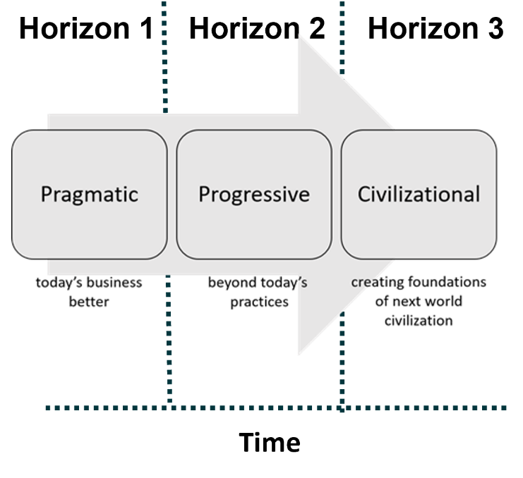
What We Use Methods for

Slide 7
Table 1. Historical foresight methods compilation
Fowles (1978) | Bell (1997) | Glenn and Gordon’s (2009)
Cross-Impact Analysis Delphi Envelope Curves Growth Curves Morphological Analysis Relevance Trees Scenarios Simulation Gaming Simulation Modeling Social Indicators Social Forecasting Systems Analysis Technology Assessment Technological Forecasting Time Series Trend Extrapolation | Chaos Theory Cohort Component Projection Content Analysis Contextual Mapping Cross-Impact Analysis Delphi Ethnographic Futures Research Future Workshops (Jungk) Issues Management Monitoring (Scanning) Participatory Pragmatic Prediction (Leading Indicators) Relevance Trees Scenarios Simulation and Computer Modeling [Simulation] Gaming Social Experiments Survey Research Technology Assessment Time Series | Agent Modeling Causal Layered Analysis Chaos and Non-Linear Systems Cross-Impact Analysis Decision Modeling Delphi Techniques Econometrics and Statistical Modeling Environmental Scanning Field Anomaly Relaxation Futures Polygon Futures Wheel Genius Forecasting, Vision, and Intuition Interactive Scenarios Morphological Analysis Multiple Perspective Participatory Methods Prediction Markets Real-Time Delphi Relevance Trees Robust Decision-making Scenarios Science and Technology Roadmapping Simulation Gaming State of the Future Index Structural Analysis Substitution Analysis Systems Modeling Technological Sequence Analysis Text Mining Toolbox for Scenario Planning Trend Impact Analysis Visioning Wild Cards

Slide 8
Patterns
In common across all 3
On 2 of 3
Cross-Impact Analysis
Delphi
Relevance Trees
Scenarios
Simulation: Gaming
Simulation: Modeling
Morphological Analysis
Technology Assessment
Technological Forecasting
Time Series

Slide 9
Table 1. Contemporary foresight methods compilation
Glenn and Gordon’s (2009)* | Popper (2008a) Handbook | Jackson Shaping Tomorrow (2013) | UNDP (2015) Foresight Manual
Agent Modeling Causal Layered Analysis Chaos and Non-Linear Systems Cross-Impact Analysis Decision Modeling Delphi Techniques Econometrics And Statistical Modeling Environmental Scanning Field Anomaly Relaxation Futures Polygon Futures Wheel Genius Forecasting, Vision, And Intuition Interactive Scenarios Morphological Analysis Multiple Perspectives Participatory Methods Prediction Markets Real-Time Delphi Relevance Trees [Science And Technology] Roadmapping Robust Decision-making Scenarios Simulation-Gaming State of the Future Index Structural Analysis Substitution Analysis Systems Modeling Technological Sequence Analysis Text Mining Toolbox For Scenario Planning Trend Impact Analysis Visioning Wild Cards | Backcasting Benchmarking Bibliometrics Brainstorming Citizens Panels Conferences/ Workshops Cross-Impact/ Structural Analysis Delphi [Environmental] Scanning Essays/Scenario Writing Expert Panels Genius Forecasting Indicators/Time Series Analysis (TSA) Interviews Key/Critical Technologies Literature Review Modeling Morphological Analysis Multi-Criteria Analysis Patent Analysis Polling/Voting Quantitative Scenarios/SMIC Relevance Trees/ Logic Charts Roadmapping Role Play/Acting Scenarios Science Fictioning Simulation Gaming Stakeholder Analysis/ MACTOR Surveys SWOT Trend Extrapolation/ Impact Analysis Wild Cards & Weak Signals (Wi-We) | Backcasting Brainstorming Causal Layered Analysis Chaos Theory Cross-Impact Analysis Decision Modeling Delphi Method Environmental Scanning Expert Panel Forecasting Futures Wheel Heuristics Modeling, Simulation, Gaming Morphological Analysis Participatory Methods Personal Futures Prediction Market Relevance Trees Road-Mapping Scenarios Technology Sequence Analysis Text Mining Trend Impact Analysis TRIZ Visioning Wild Cards | Agent-Based Modeling Appreciative Inquiry Backcasting Causal Layered Analysis Conference Model Cross-Impact Analysis Delphi Method Drivers Analysis Engaged Foresight Environmental / Horizon Scanning Expert Panel Forecasting Future Search Futures Wheel Heuristics Management By Discovery Modelling, Simulation and Gaming Morphological Analysis Narrative Inquiry Real Time Strategic Change Relevance Trees Roadmapping Scenario Planning / Building STEEP Analysis Stress-Testing Technology Sequence Analysis Text Mining Trend Impact Analysis TRIZ (Theory of Inventive Problem Solving) Wild Cards and Weak Signals Search Conference Visioning Whole Scale Change Windtunnelling

Slide 10
Observations
The 10 bolded items appeared on all four lists
The 7 underlined items appeared on three of the four lists
The 11 italicized items appeared on two of the four lists
The 43 items in regular font appeared on just one list
The total number of single items, 43, exceeded the combined total of the multiple items, 28. This suggests that the core tool kit used by most futurists is relatively small and that there are many single variations used occasionally by a handful of practitioners.
It was interesting to see that Environmental Scanning, which many futurists would say is arguably the most important method, is not on the Fowles 1978 list and appears on Bell’s 1997 list as monitoring. It makes its first appearance as Environmental Scanning on Glenn and Gordon’s list in 2009.
It was interesting to see Causal Layered Analysis (CLA) include in Glenn and Gordon in 2009. But none of the lists include Integral Futures as a method yet

Slide 11
Nash’s Dissertation on Corporate Foresight
Nash’s dissertation work assessing the state of corporate foresight identified the five most frequently mentioned methods were:
scenario planning (18%)
trend analysis (16%)
environmental scanning (10%)
workshops (6%)
looking for weak signals (5%)

Slide 12
New Since 2005 in KBFS
Aspirational Futures (method)
Bibliometric mapping (tool)
Anticipatory Governance (approach/perspective)
Design futures (approach/perspective)
Ethnographic Experiential Futures (method)
Four Futures Archetypes (technique)
Foresight Competency Model (tool)
Foresight Maturity Model (tool)
Framework foresight (method)
Integral Futures & Integral Strategy (approach/perspective)
Polak Game (technique)
Presencing (method)
Science Fiction Prototyping (method)
Three Horizons (tool)

Slide 13
Nine Directions
Moving down the value chain
Re-imagining imagining
Rethinking wildcards
Mainstreaming of critical and integral futures
More nuanced approach to time using Three Horizons
Greater integration of qualitative and quantitative
More participatory approaches
More experiential approaches
More focus on evaluation

Slide 14
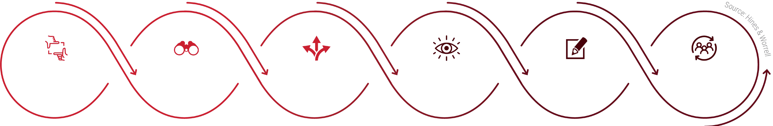
1. Moving Down the Value Chain
MAPPING
INFLUENCING
FRAMING
SCANNING
FUTURING
VISIONING
DESIGNING
ADAPTING
scoping the project and
current assessment
searching for signals
of change and specific future inputs
identifying baseline and alternative futures
exploring the implications of future scenarios
crafting options
and an integrated strategic approach
communications, ongoing monitoring and implementation
Domain Description Domain Map
Research
Scanning
Library
Baseline &
Alternative Futures
Implications
Options
Integrated Approach
Actions
Monitoring
Library

Slide 15
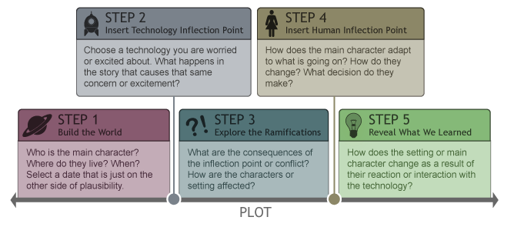
2. Re-imagining imagining
Sci Fi Prototyping
The SFP architecture: Designing the future in five easy steps

Slide 16
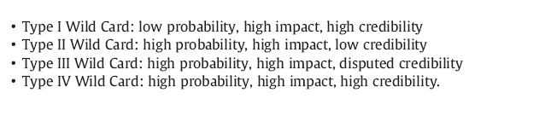

3. Rethinking wildcards

Slide 17
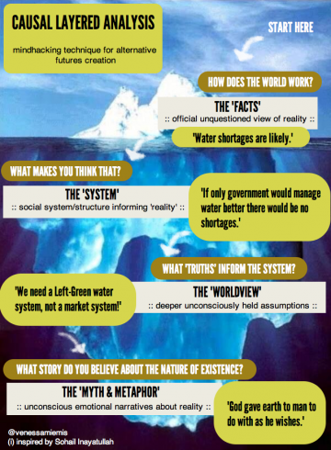
4. Mainstreaming of critical and integral futures

Slide 18
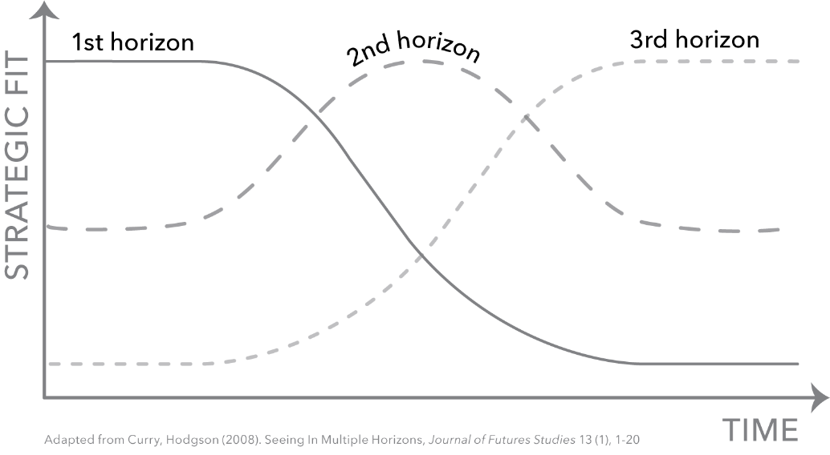
5. More nuanced approach to time using Three Horizons

Slide 19
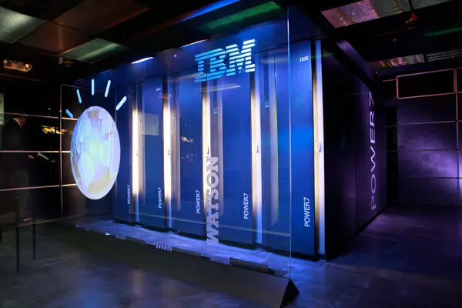
6. Greater integration of qualitative and quantitative

Slide 20
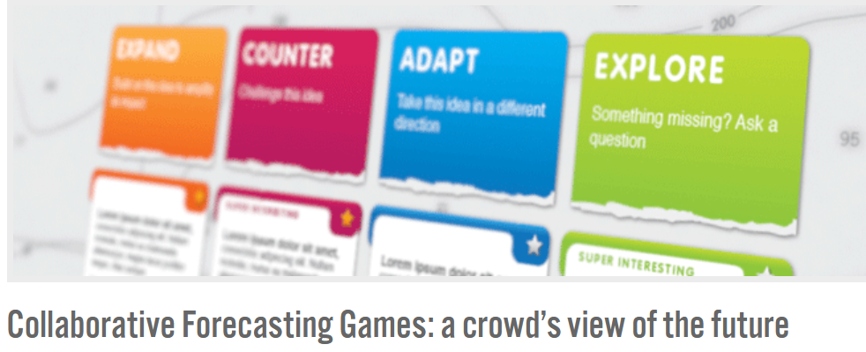
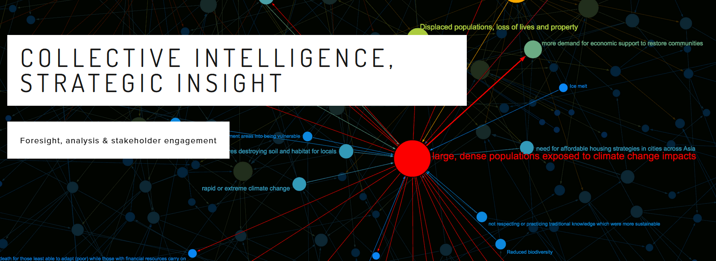
7. More participatory approaches
IFTF ‘s
Foresight Engine
Futurescaper

Slide 21
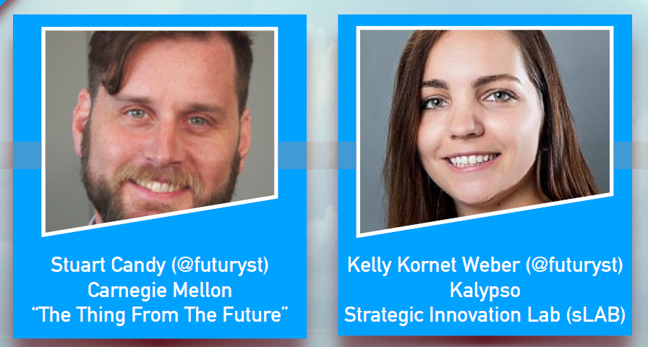
8. More experiential approaches

Slide 22
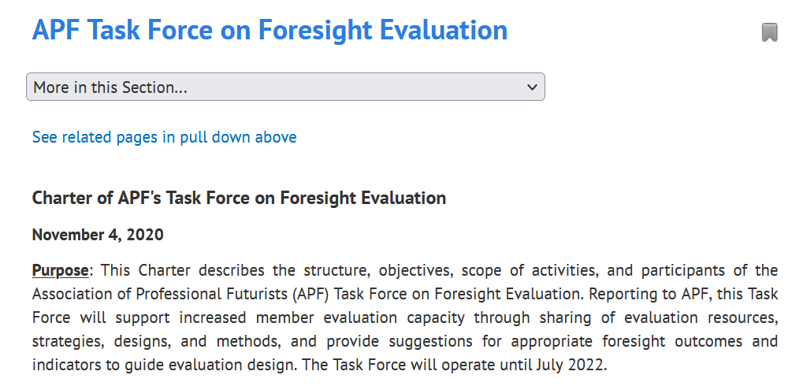
9. More focus on evaluation

Slide 23
Conclusions
  1. Field consensus on methods is greater than believed
There have been complaints for years that futurists could not agree on methods and that the field was fragmenting. There was a feeling that the differences were greater than the similarities. Indeed, the APF’s 2003 Futures of Futures Scenario salon noted a high degree of disagreement and fragmentation in the field (Hines 2003).
2. The methods tool kit is healthy and growing.
The author’s recent work co-editing the Knowledge Base of Futures Studies (KBFS) 2020 with a particular focus on the methodological developments of the last 15 years revealed a healthy development of 14 new or updated perspectives, methods, tools, and techniques. The field is innovating from its foundation of agreed up on competencies that comprise the basic methods of doing foresight work. One can analyze the new methods and techniques and see how they align with field’s core competencies.

Slide 24
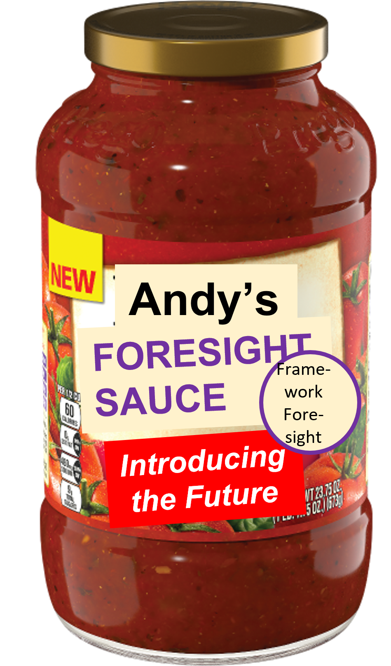
Lastly, What’s Your Foresight Sauce?

Slide 25
Small Group Exercise
Discuss what is in your tool kit
Each group is given a consulting challenge to approach
How would you design the steps

Slide 26
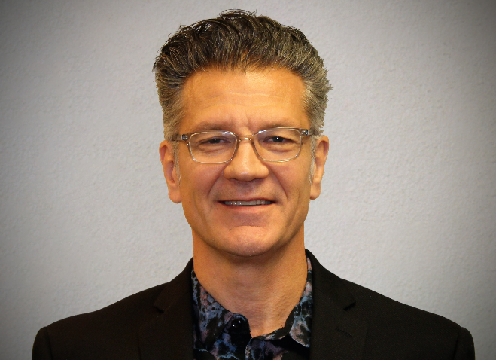
Contact Info
Andy Hines
U of Houston Foresight
Associate Professor &
Program Coordinator
ahines@uh.edu
www.andyhinesight.com
26

Slide 27
Fill-in-the-Blank Foresight
One who is new to foresight may be overwhelmed by the seeming proliferation of varieties of foresight. One might call it “fill-in-the-blank” foresight. Some examples include:
social foresight (Slaughter 2004)
corporate foresight (Daheim & Eurz 2006)
adaptive foresight (Eriksson 2008; Smart 2019)
strategic foresight (Slaughter 2009)
technology foresight (Martin 2010)
participatory foresight (Kuosa 2015)
transformative foresight (Inayatullah and Sweeney 2021)

