Slide 1
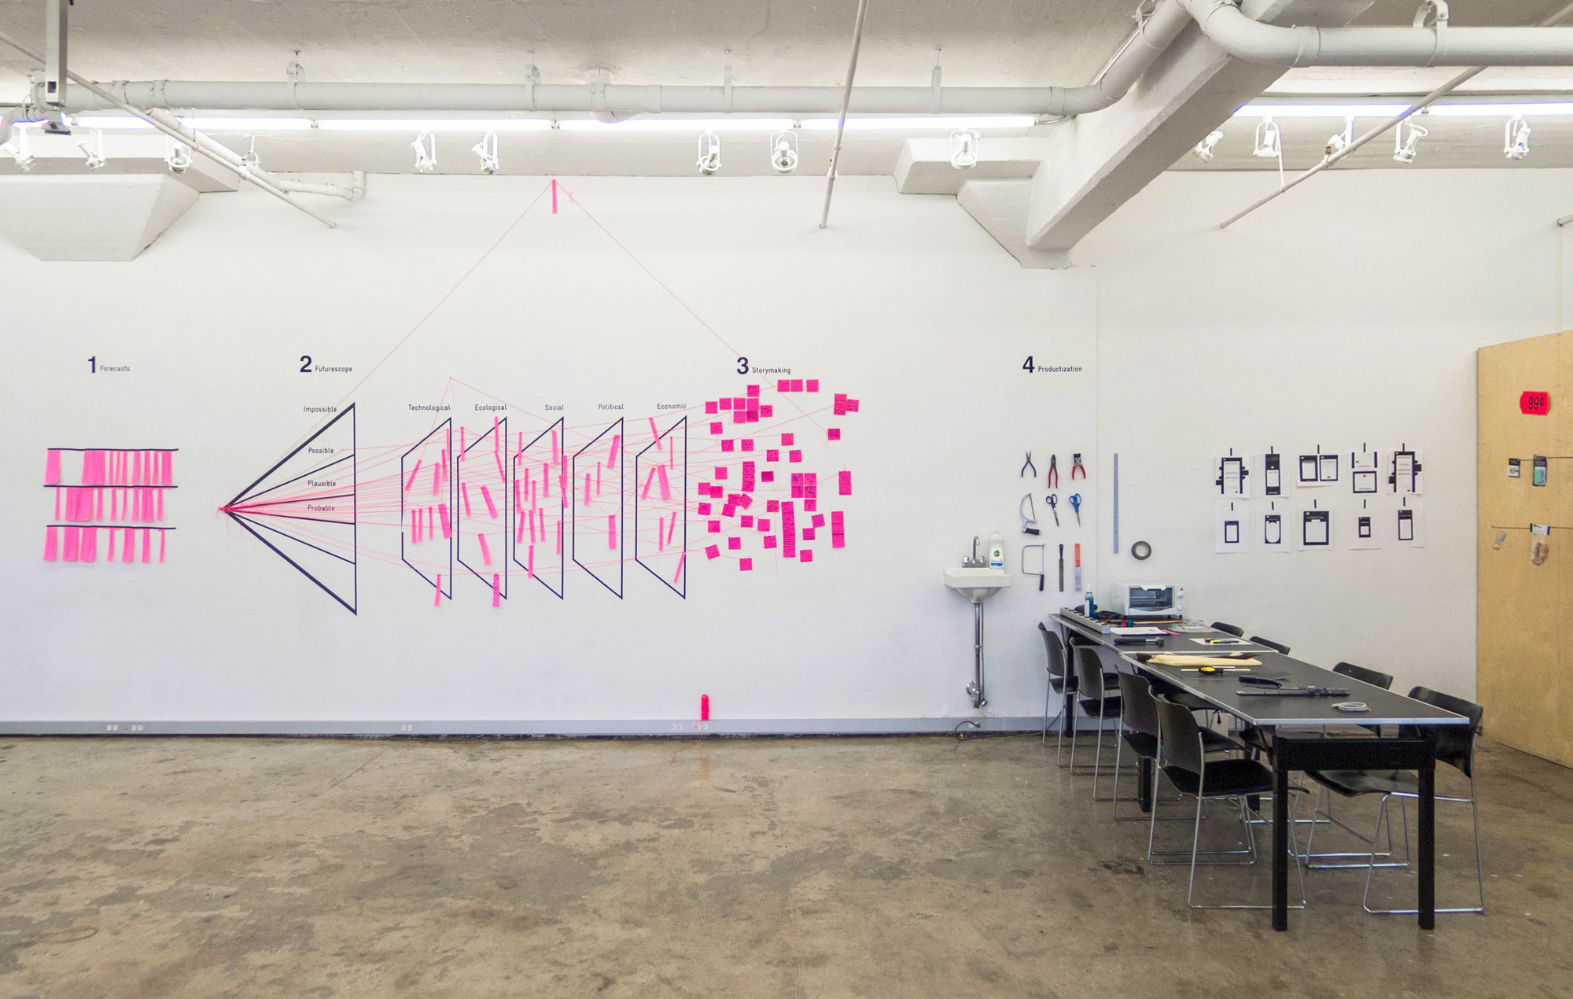
Design Futures
Spring Gathering
Notes:
Extrapolation Factory

Slide 2
Prologue

Slide 3
THIS IS A
CIRCLE
Notes:
Circle in the air…

Slide 4
What Is Design Futures?
Notes:
Ask!

Slide 5
“Creating tangible and immersive representations of the future to challenge assumptions and create discourse with the intent of provoking response.”
Ali, Chris, Elizabeth, Juli, Heather, Jim, Kiran, Denise

Slide 6
“Realizing the trajectory of the future. Making the intangible (“what’s next”) tangible. Creating provocative props for conversations about the future we want and the implications for us in the present. Solving for future need states.Interacting with emerging possibilities.”
Jenny, Martin, Eben, Sid, Mushfiqa, Jeff, Vinny

Slide 7
“Design Futures is a hybrid discipline of futures thinking and design with an emphasis on designing futures that create lasting positive impact.It is purpose driven and creates visual representations that communicate the futures we all imagine and are relatable for intended audiences.It takes the inputs of users to design futures through integrating design thinking methods.”
Josh, Jonathan, Liz, Ingrid, Sarah, Kelly, Michael

Slide 8
“Design futures walks an experiential tightrope between problem-solving in the present and sense-making of futures to inspire action between stakeholders across a system”
Jillian, Jeremy, Sara, Sarah, David, Richard, Hauson, Abdulrahman

Slide 9
DESIGN FUTURES
FUTURES
DESIGN
Notes:
Imagination as lesser ontology

Slide 10
Why Design Futures?

Slide 11
World
Building
World
Making

Slide 12
“It is increasingly acknowledged within the futures studies
community that operating with a largely verbal and theoretical
bent over the past half century has afforded too little impact on
actual future-shaping behaviors. Meanwhile, those in the design
community recognize a need to interrogate higher-level
consequences – the futures, the worlds – that their products,
systems and other outputs help produce.”
Stuart Candy and Cher Potter
Notes:
Introduction to the Special Issue: Design and Futures (Vol. I)”. Design and
Futures. Taipei: Tamkang University Press, 2019. Print. Pg 1.

Slide 13
“Everyone designs who devises courses of action aimed at changing existing situations into preferred ones”
Herbert Simon

Slide 14
Areas of Convergence
Futures
Design
Anxiety: about lack of influence on the future
Actionless mind
In/Out: Inbound & outbound change
Democratize: Futures literacy
Used: New images of the future
Anxiety about too much influence on the future
Mindless action
In/Out: Ontological design
Democratize: Participatory design
Used: The future as emerging constraint

Slide 15
Adversarial Design
Anti-Design
Contestational Design
Critical Design
Critical Jugaad
Design Fiction
Dissident Design
Experiential Futures
Guerrilla Futures
Interrogative Design
Radical Design
Reflective Design
Speculative Design
Speculative Re-design
Speculative Fiction
Tactical Media
Un-Design
Discursive Design
Notes:
(adapted from) Discursive Design: Critical, Speculative, and Alternative Things: Bruce M. Tharp and Stephanie M. Tharp

Slide 16
Design Minds
&
The Speculative

Slide 19
Experiential Futures

Slide 20
Notes:
Experiential Futures Ladder Telephone Game

Slide 21
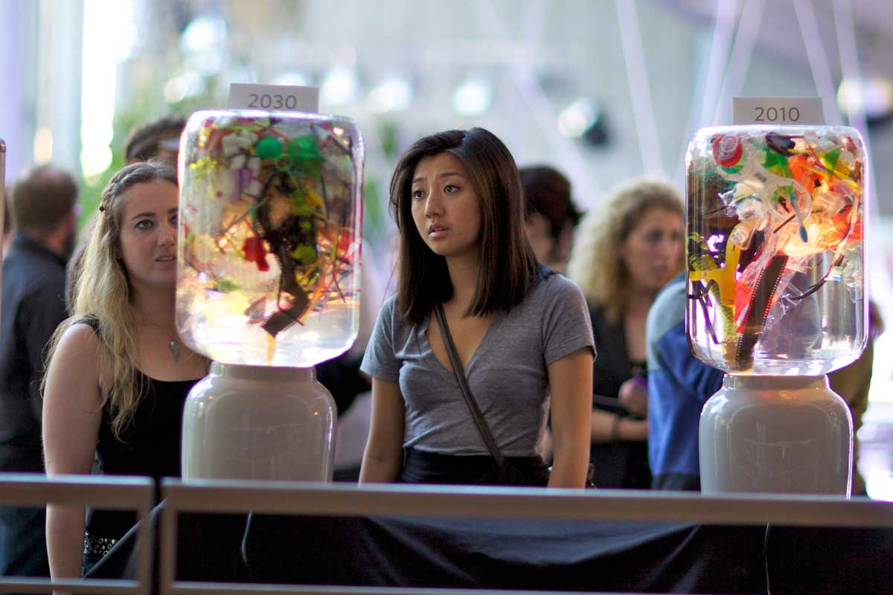
Notes:
Plastic Century: interactive installation at California Academy of Sciences. Project by Stuart Candy, Jake Dunagan, Sarah Kornfeld and Wallace J Nichols, San Francisco 02010. Photo by Mike Estee.

Slide 22
the experiential gulf

Slide 23
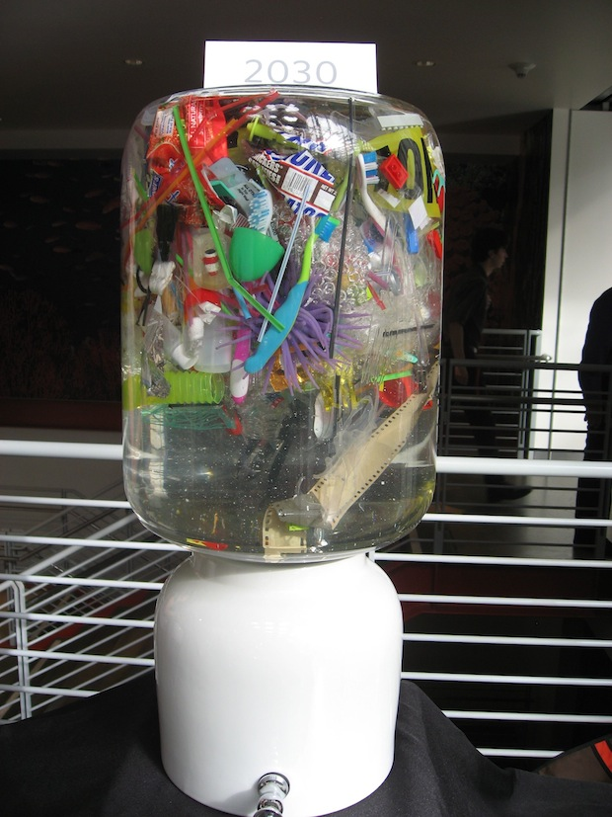
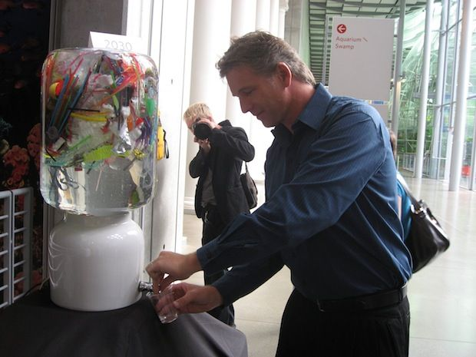
Notes:
https://www.fastcompany.com/1657283/plastic-pollution-water-drink

Slide 24
Notes:
https://medium.com/@futuryst/u-s-earth-force-58a2c1576d35

Slide 25
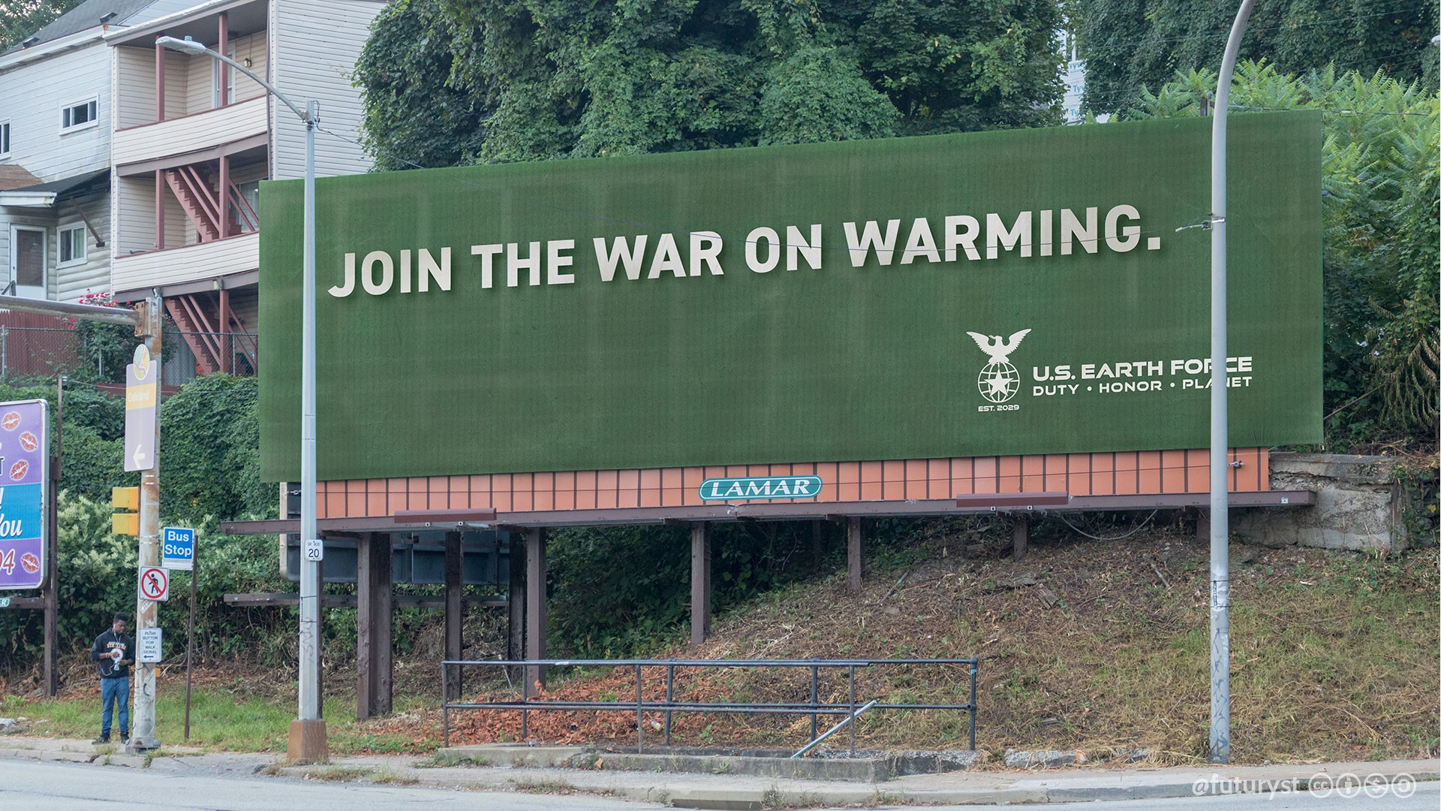
Notes:
https://medium.com/@futuryst/u-s-earth-force-58a2c1576d35

Slide 26
EXF and Anthropological Futures

Slide 27
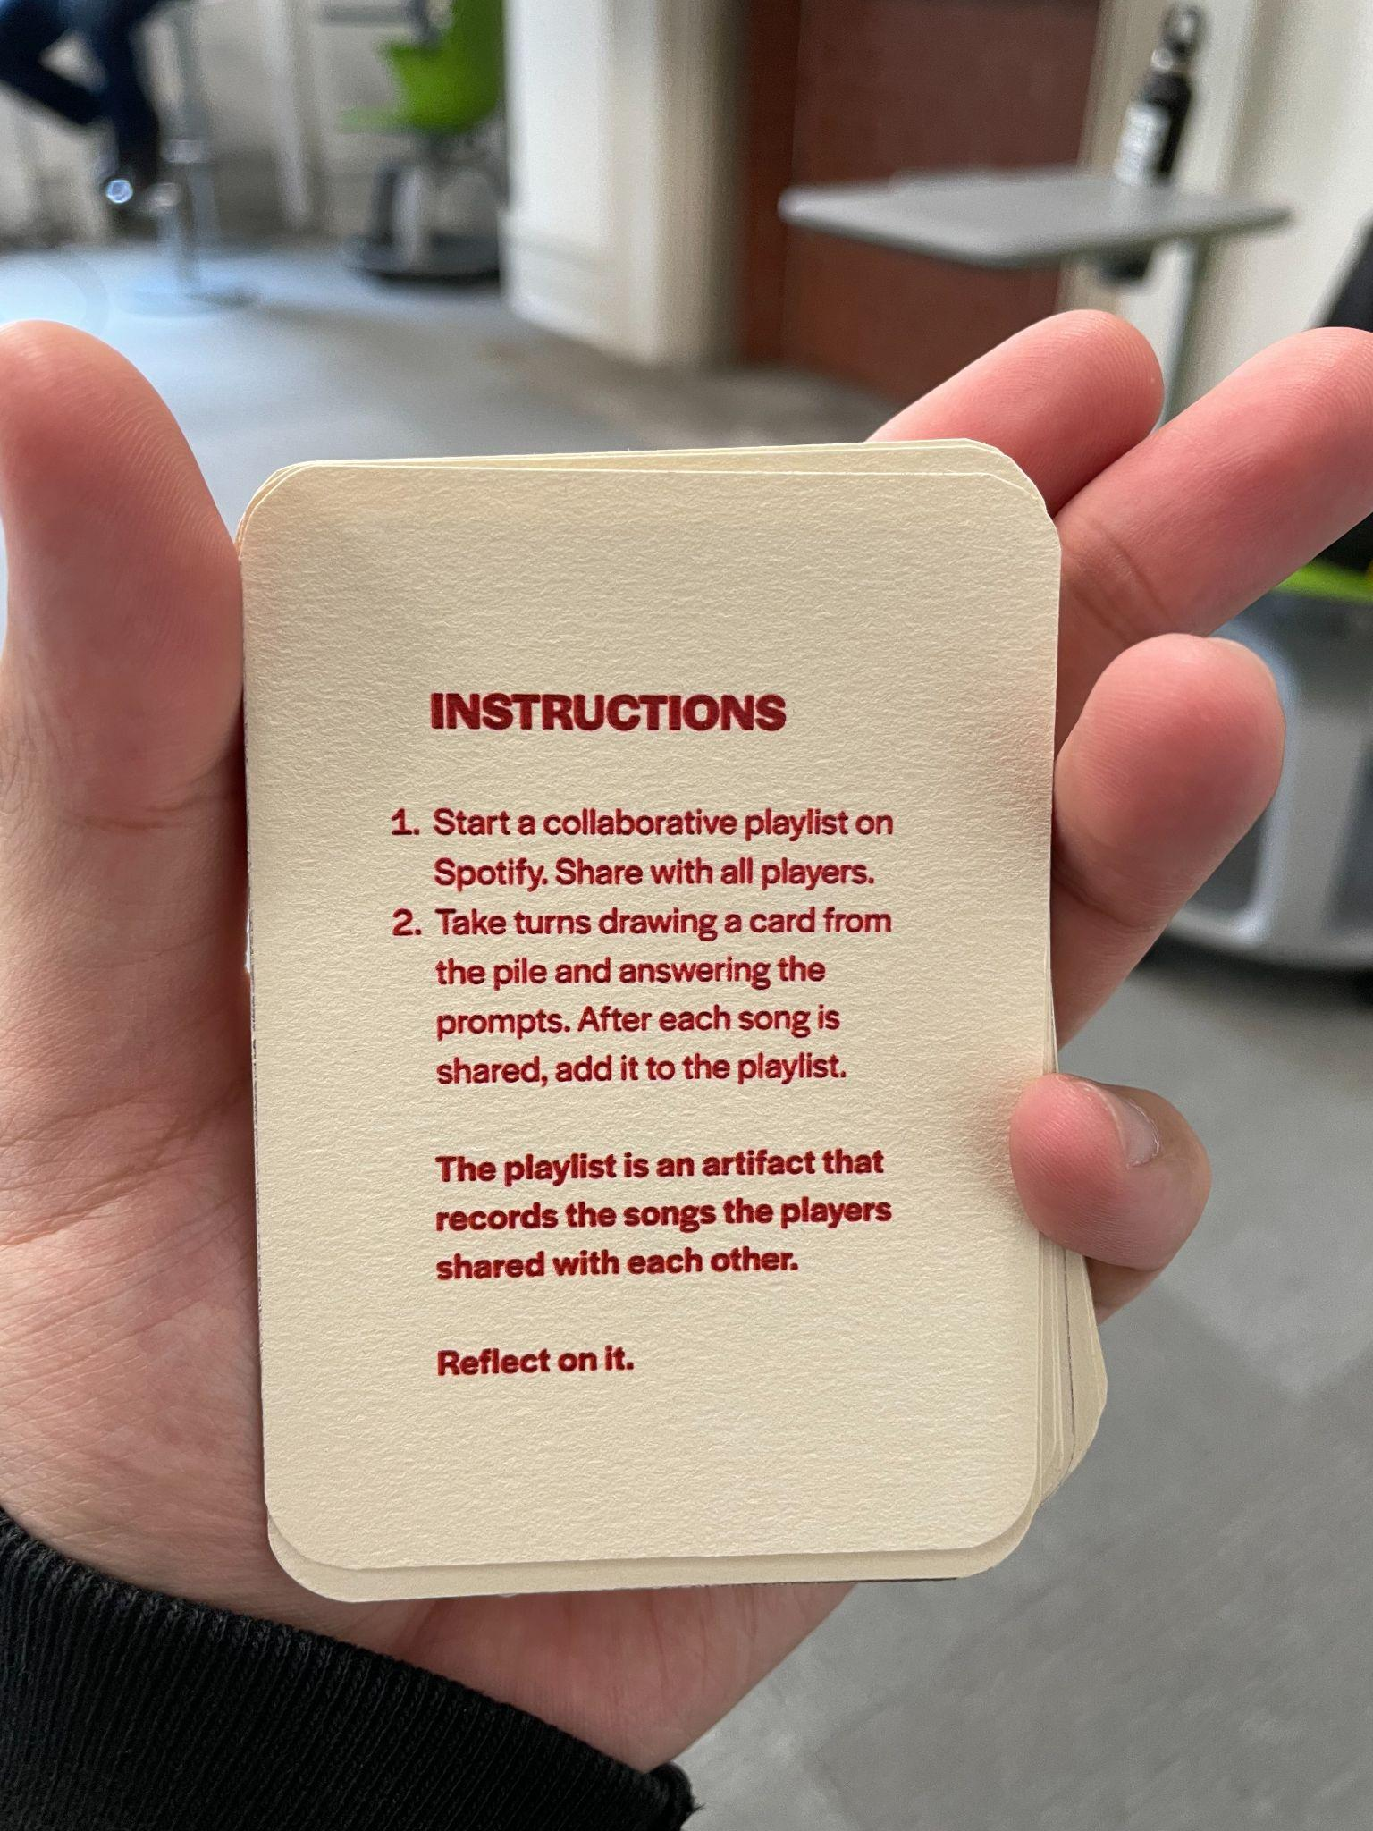
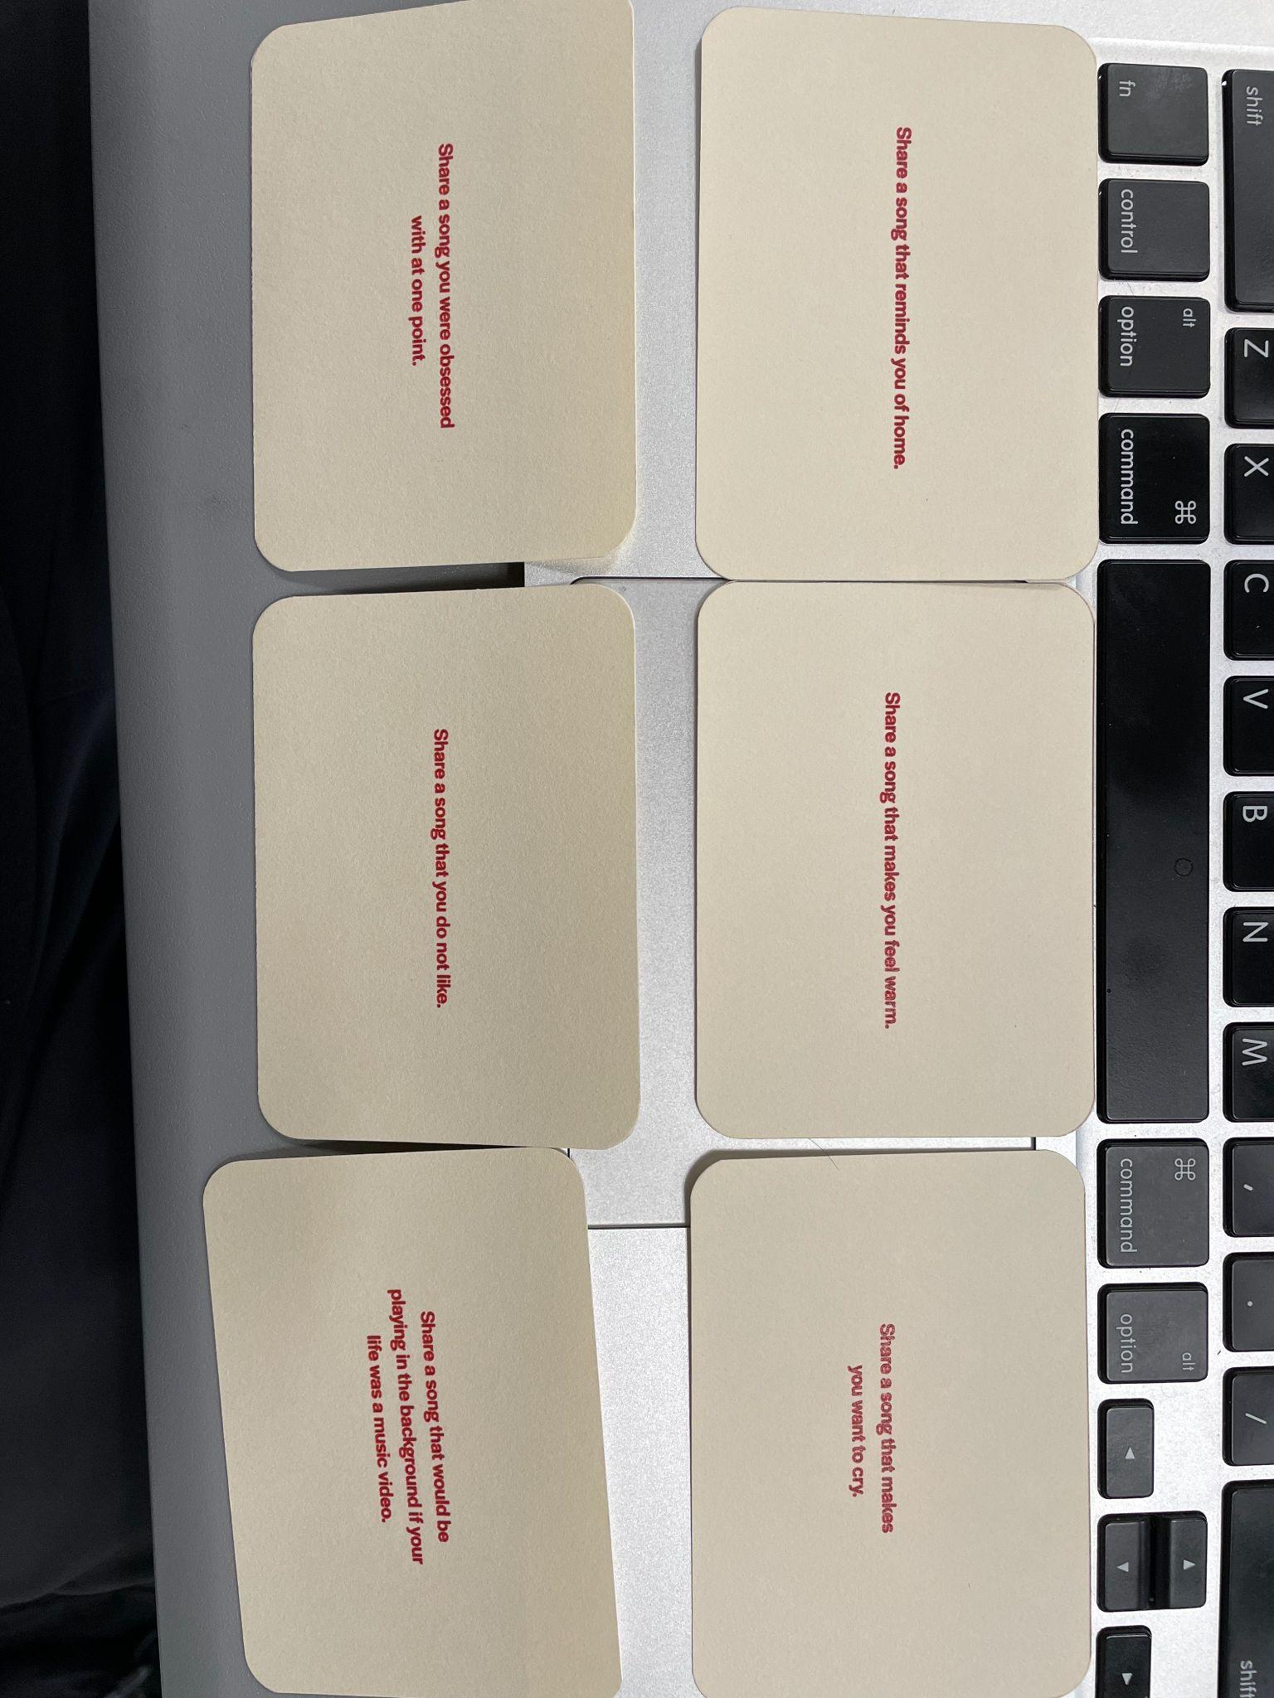
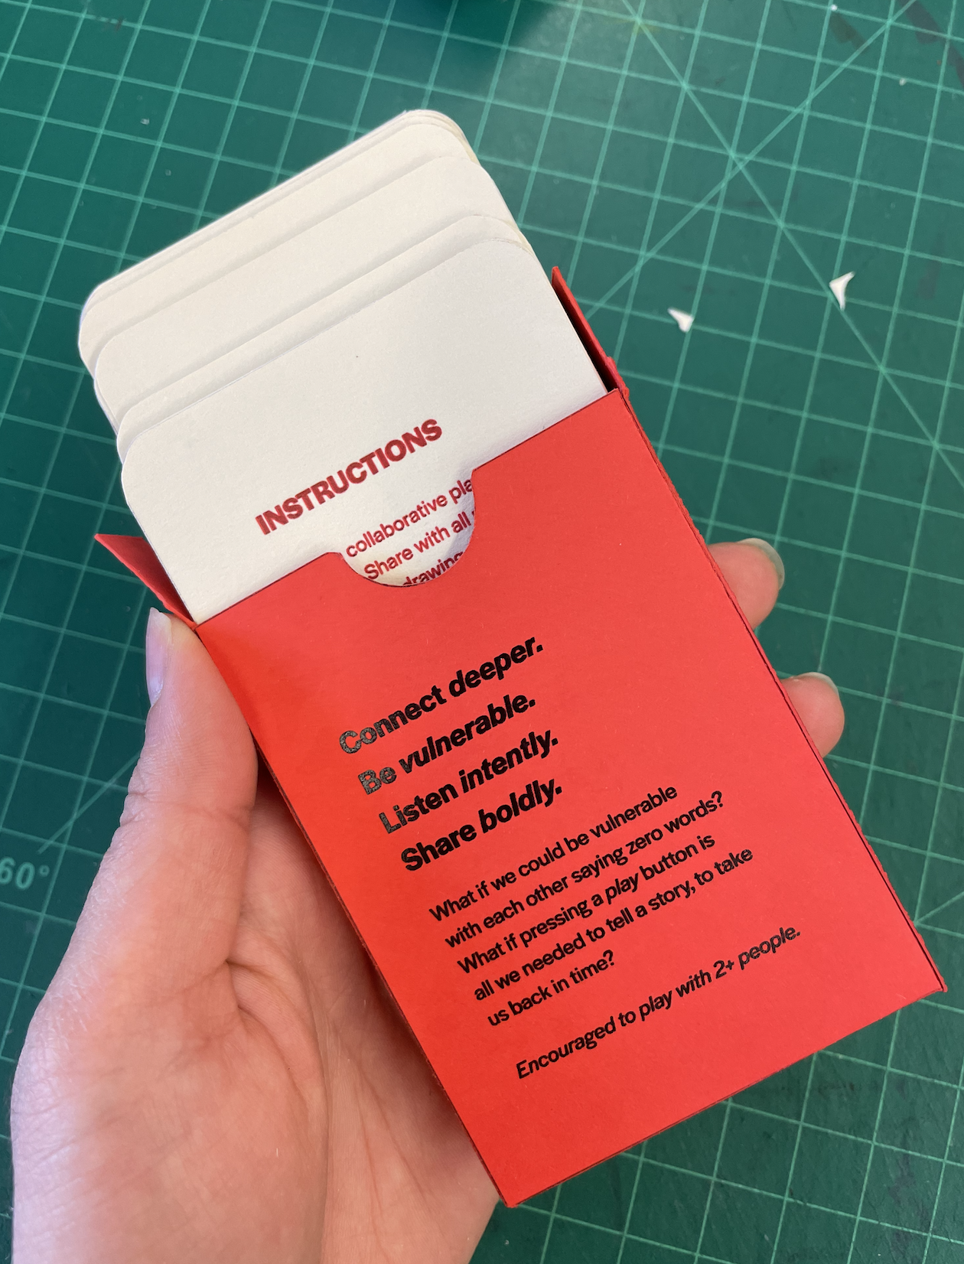
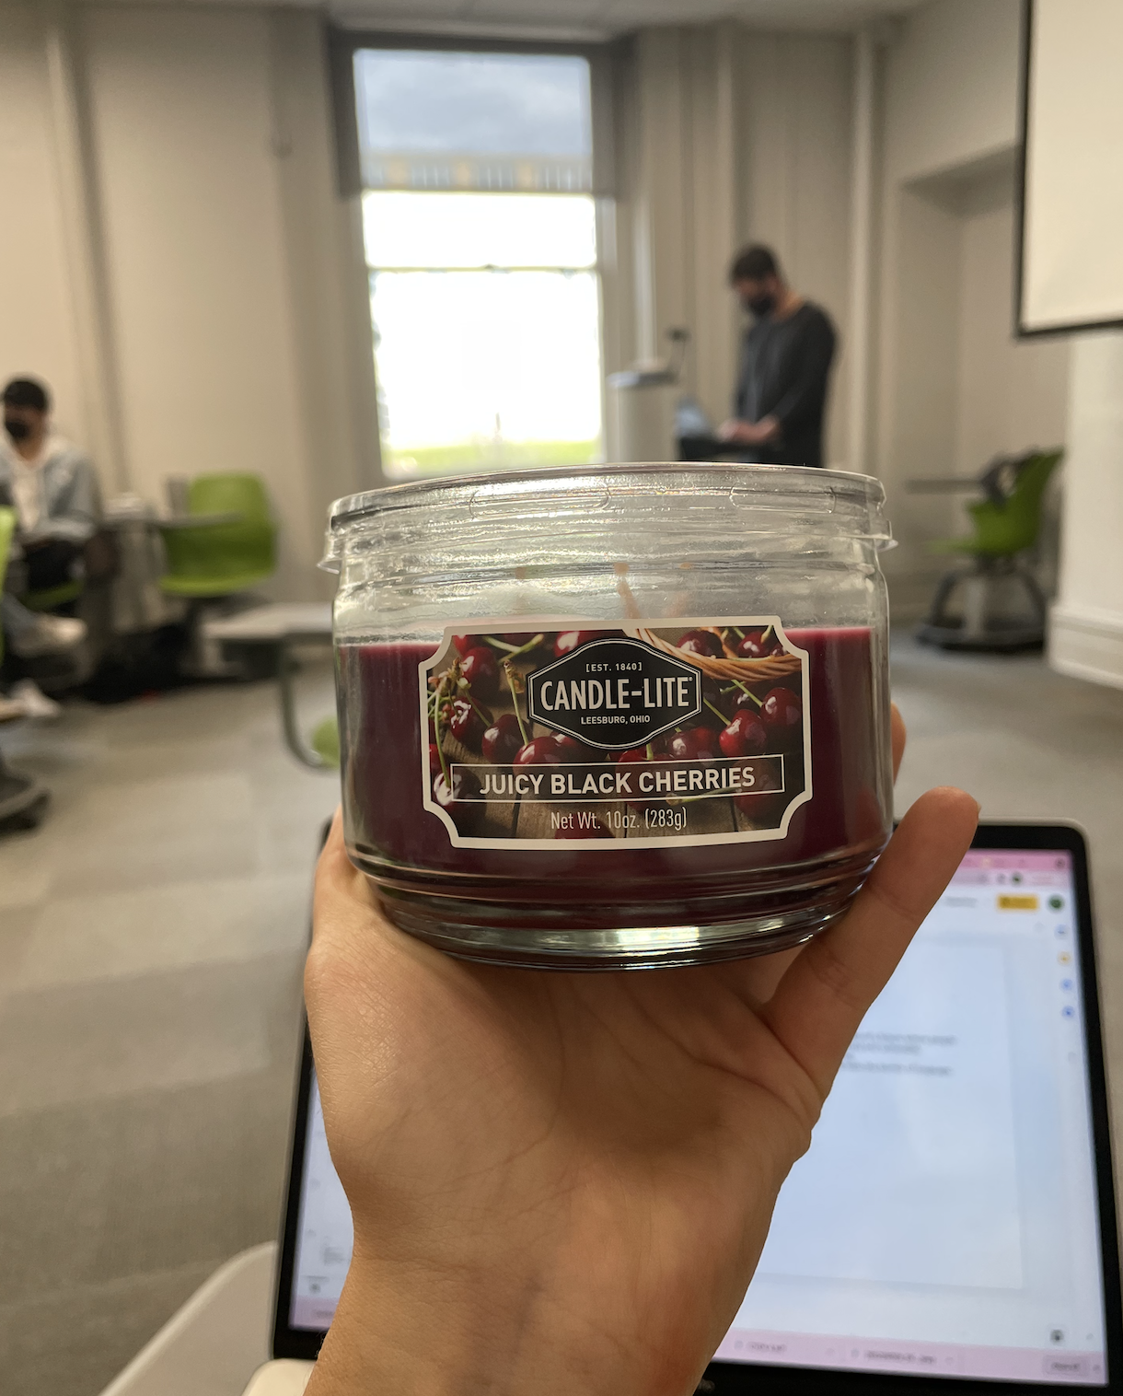
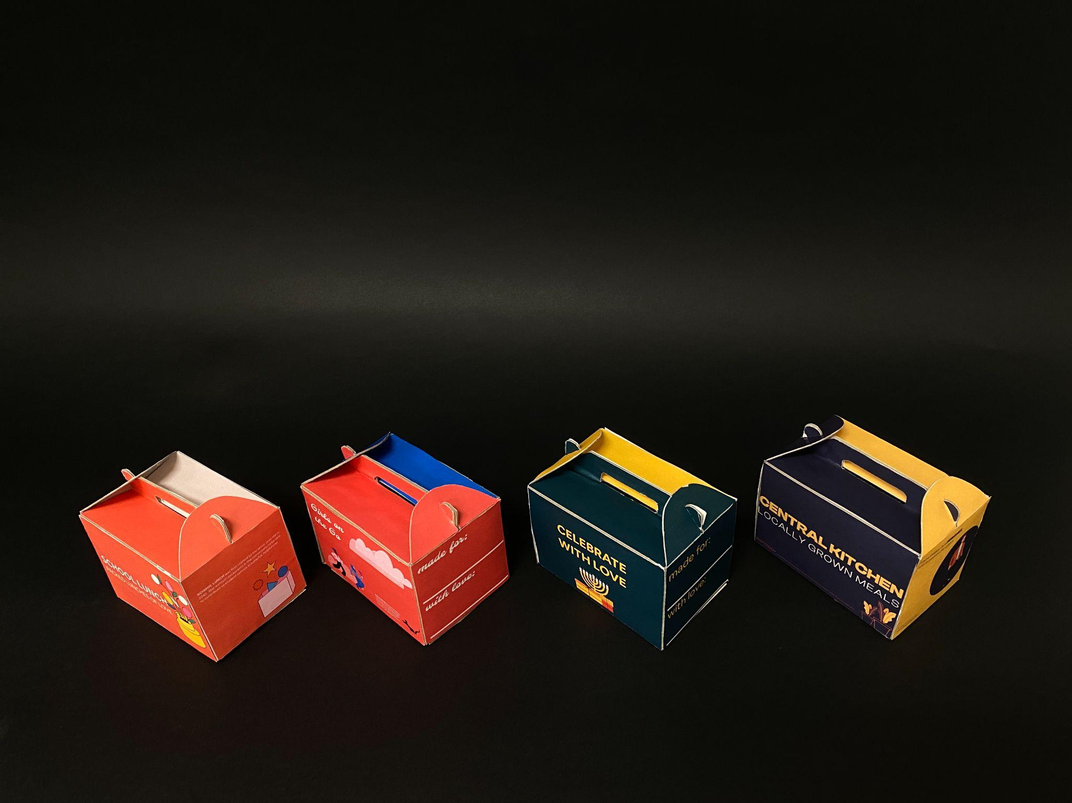
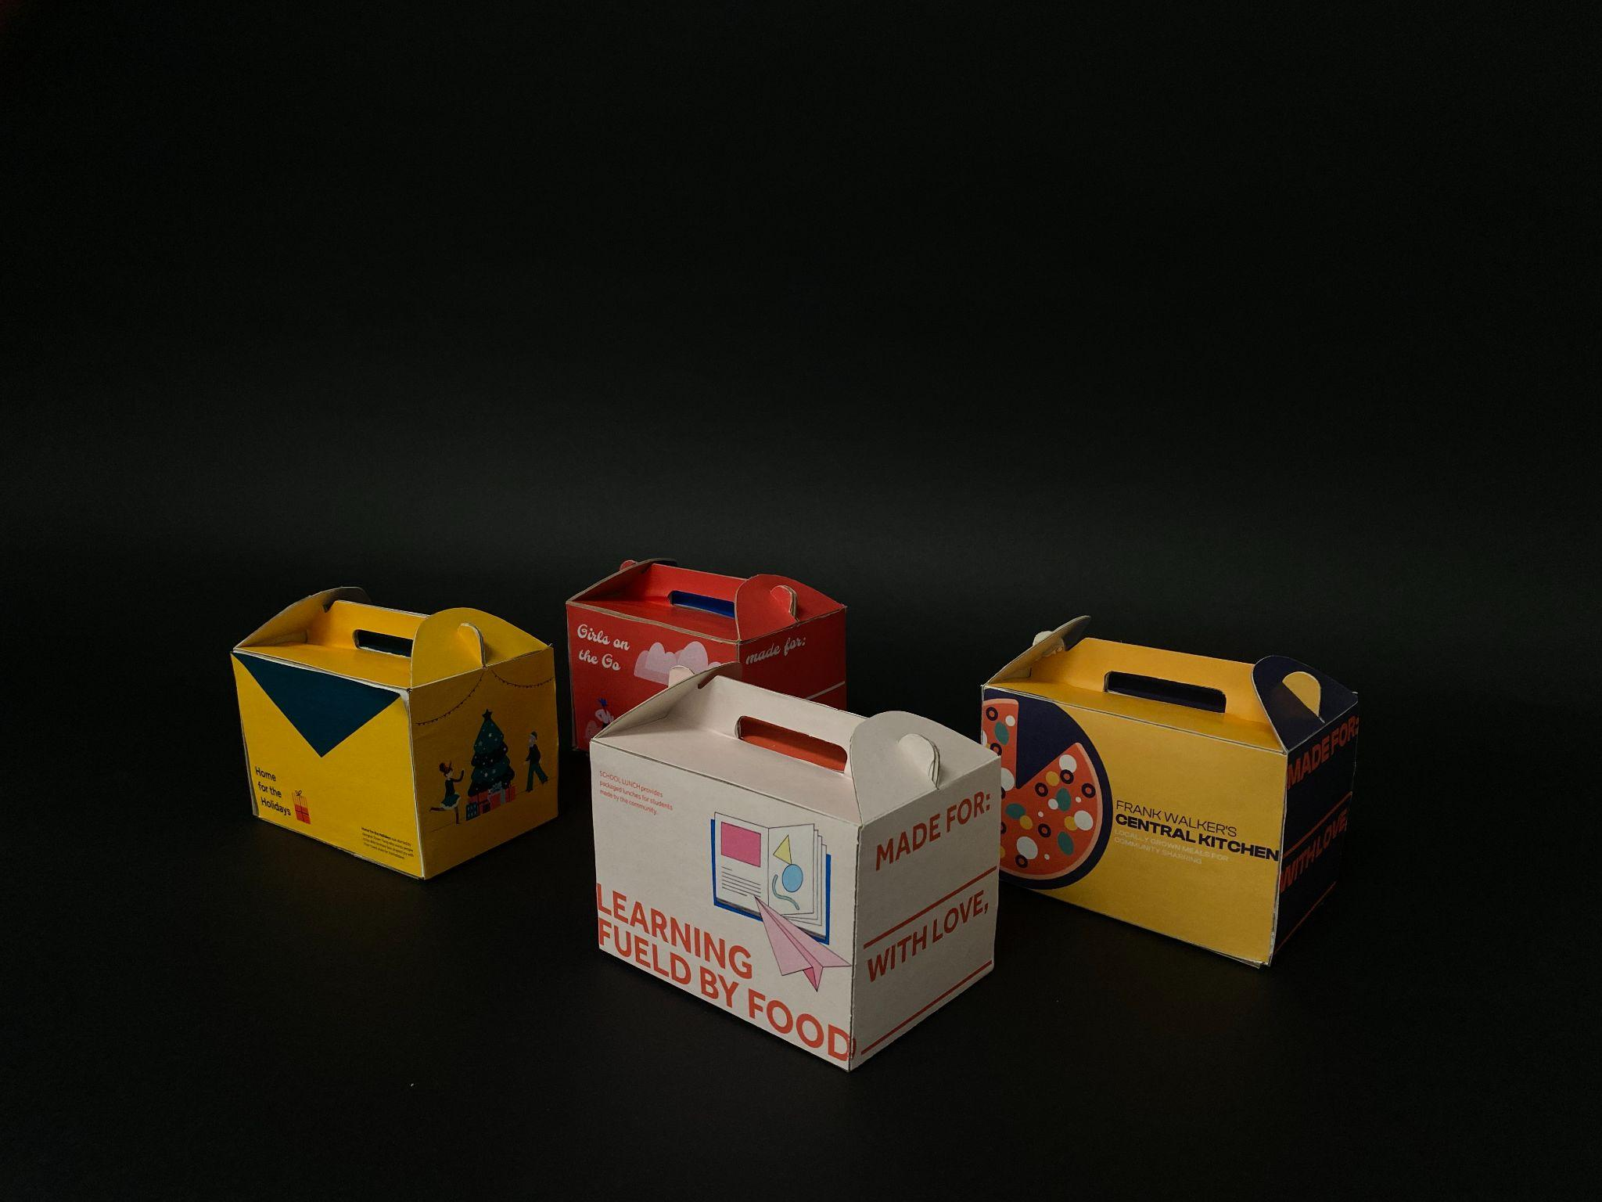
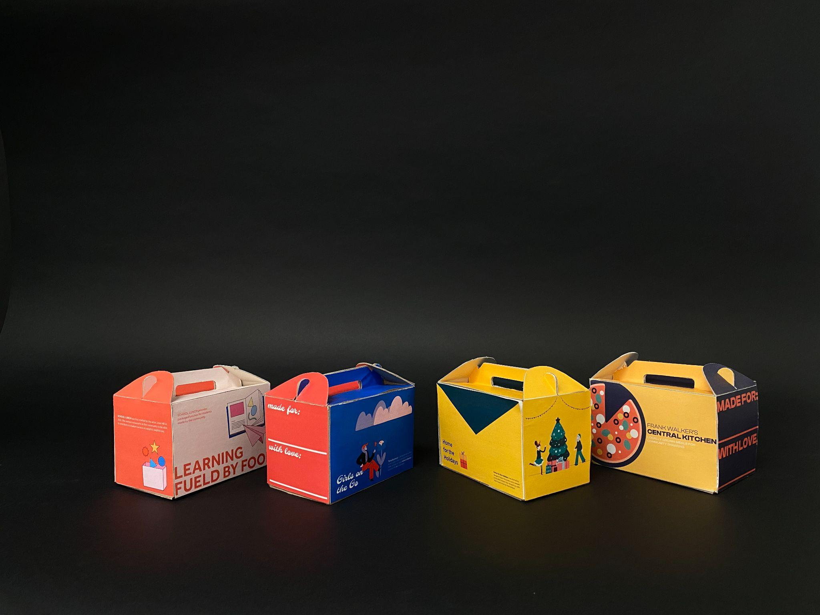

Slide 28
Transition Design

Slide 29
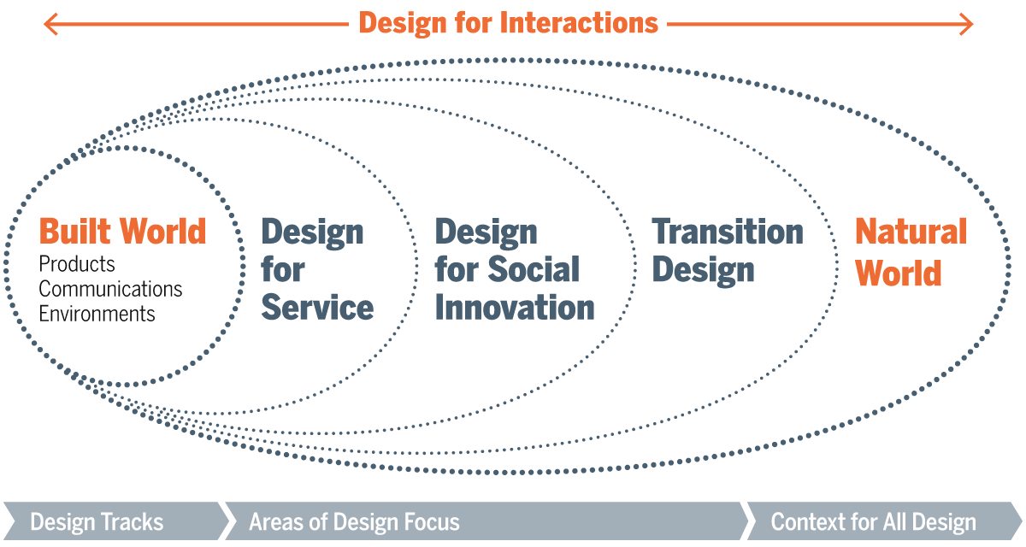

Slide 30
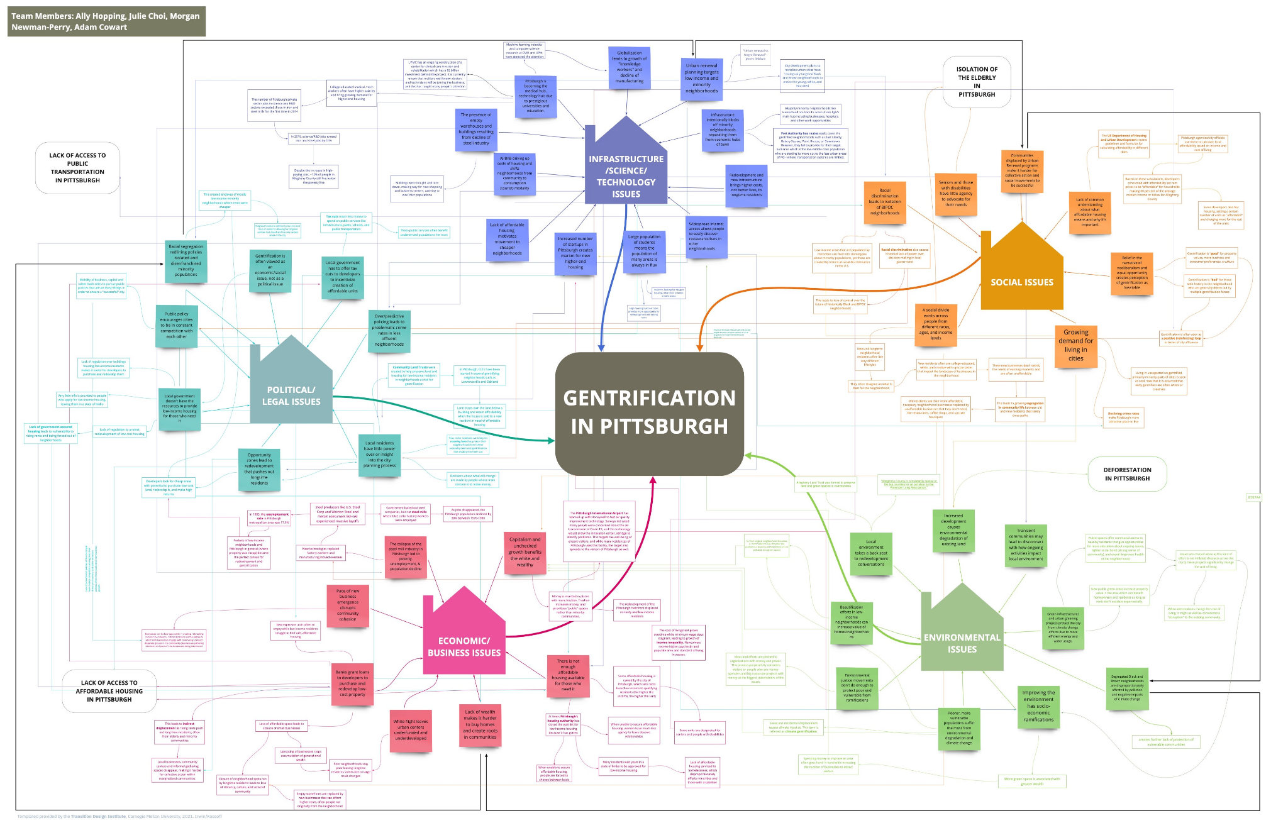
Wicked Problem

Slide 31
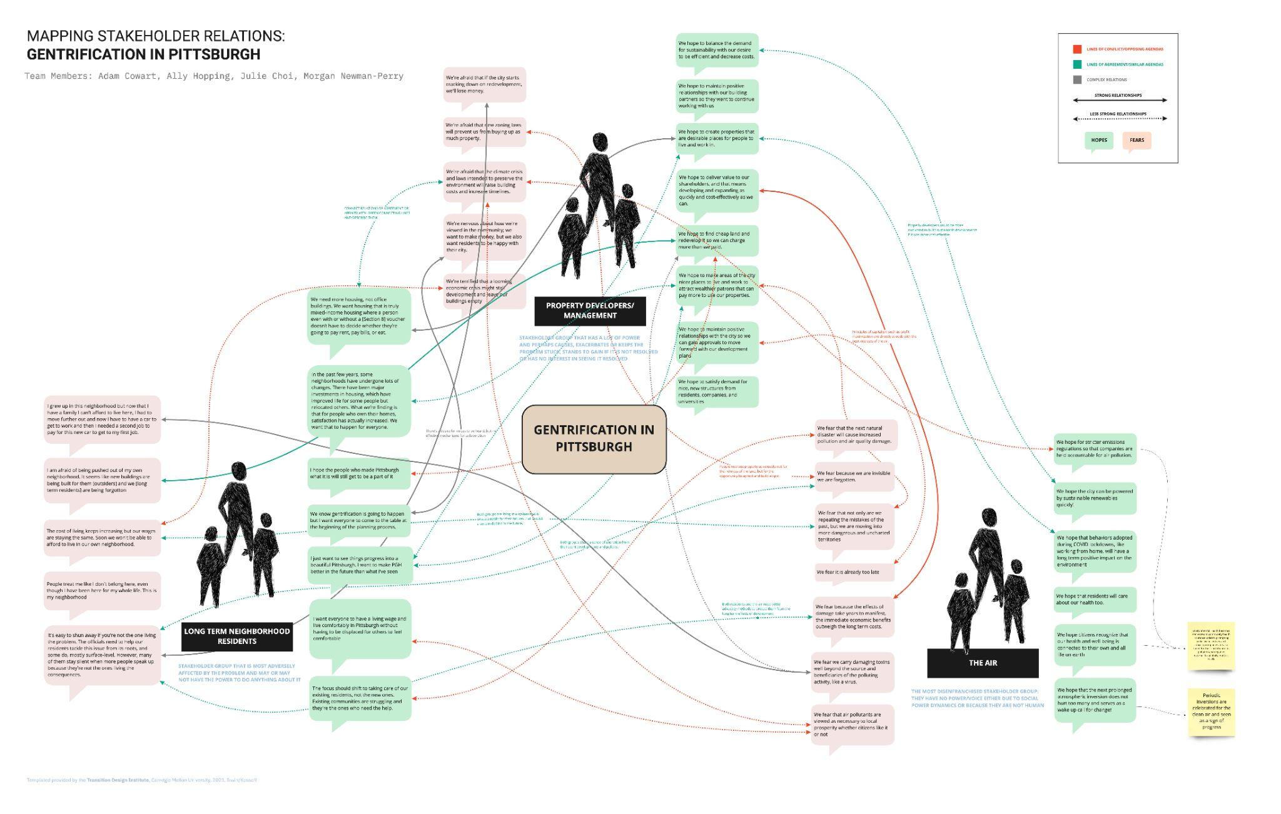
Stakeholders
Notes:
Adam

Slide 32
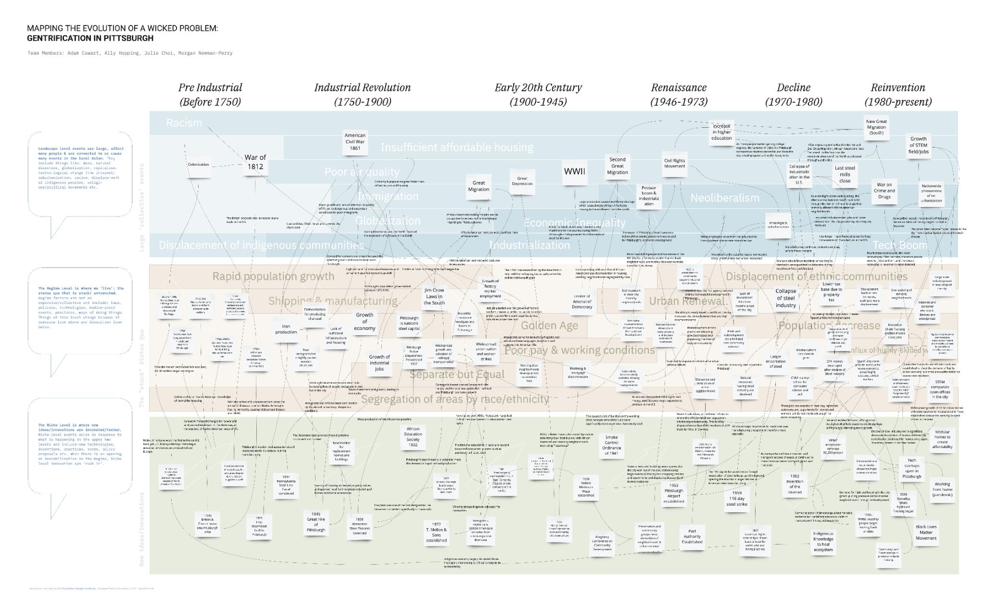
Multi-Level Perspective
Notes:
Adam

Slide 33
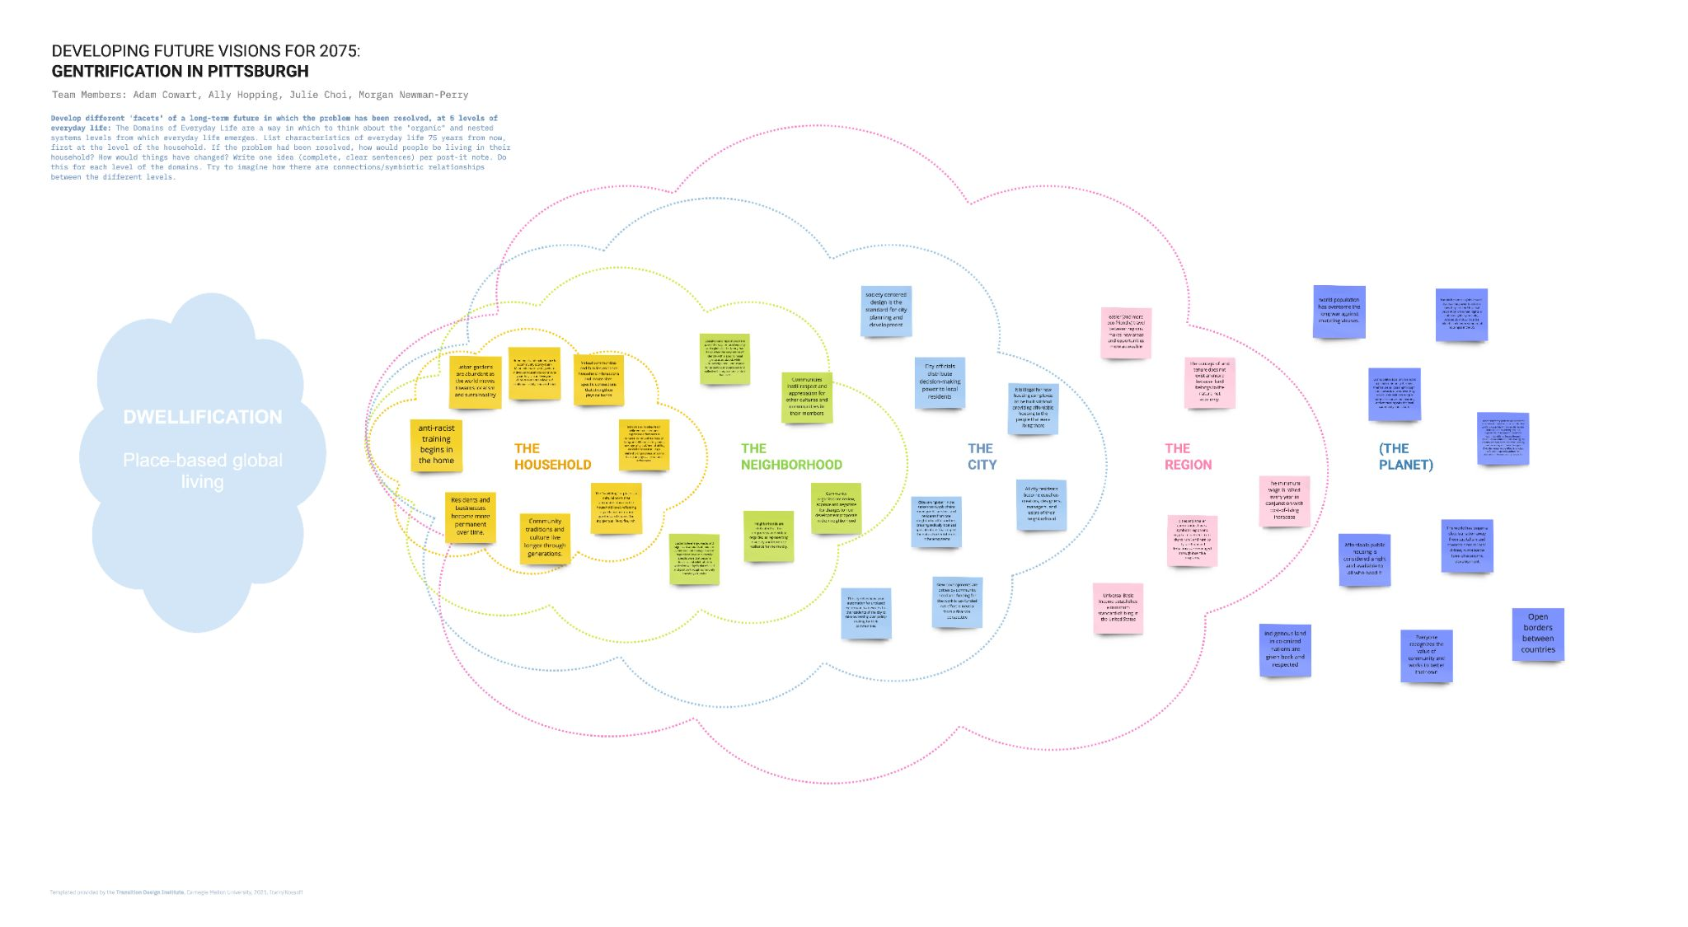
Visioning / Futuring
Notes:
Adam

Slide 34
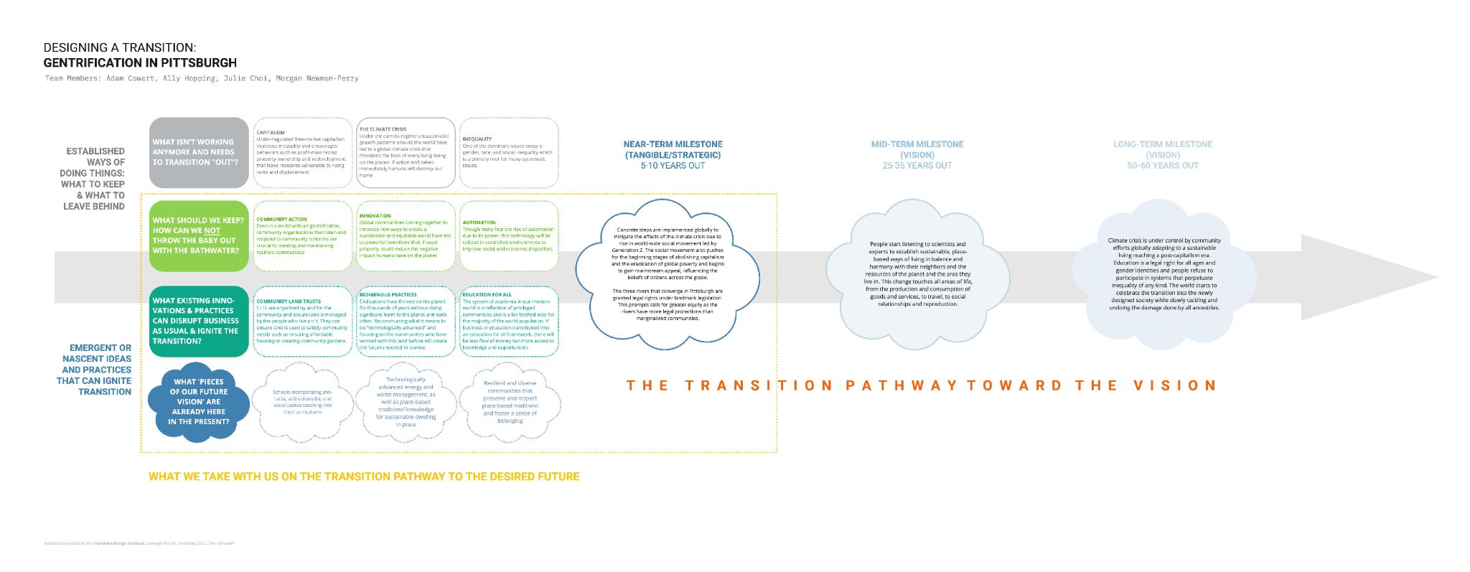
Visioning / Futuring
Notes:
Adam

Slide 35
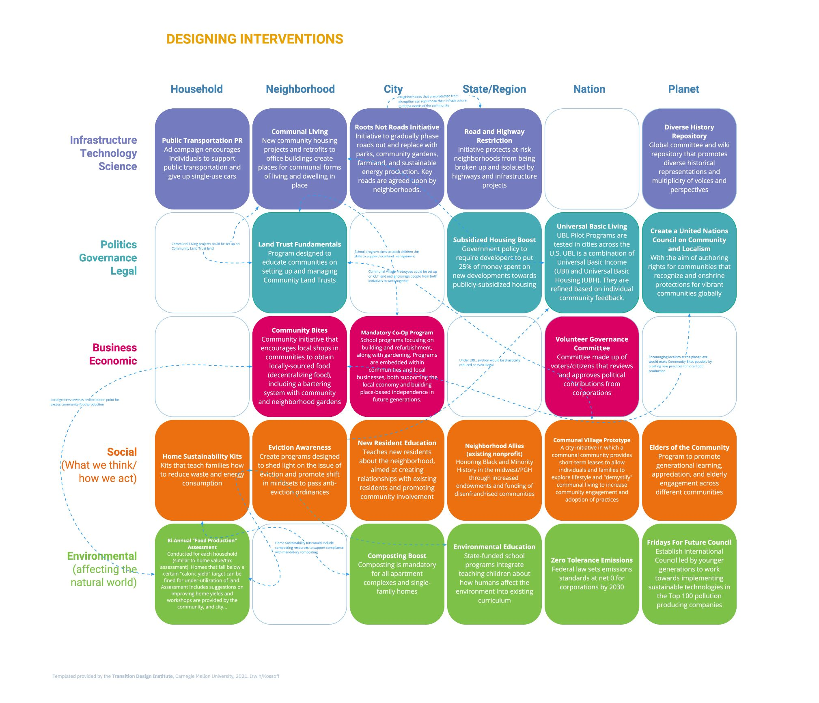
Designing for Transitions
Notes:
Adam

Slide 36
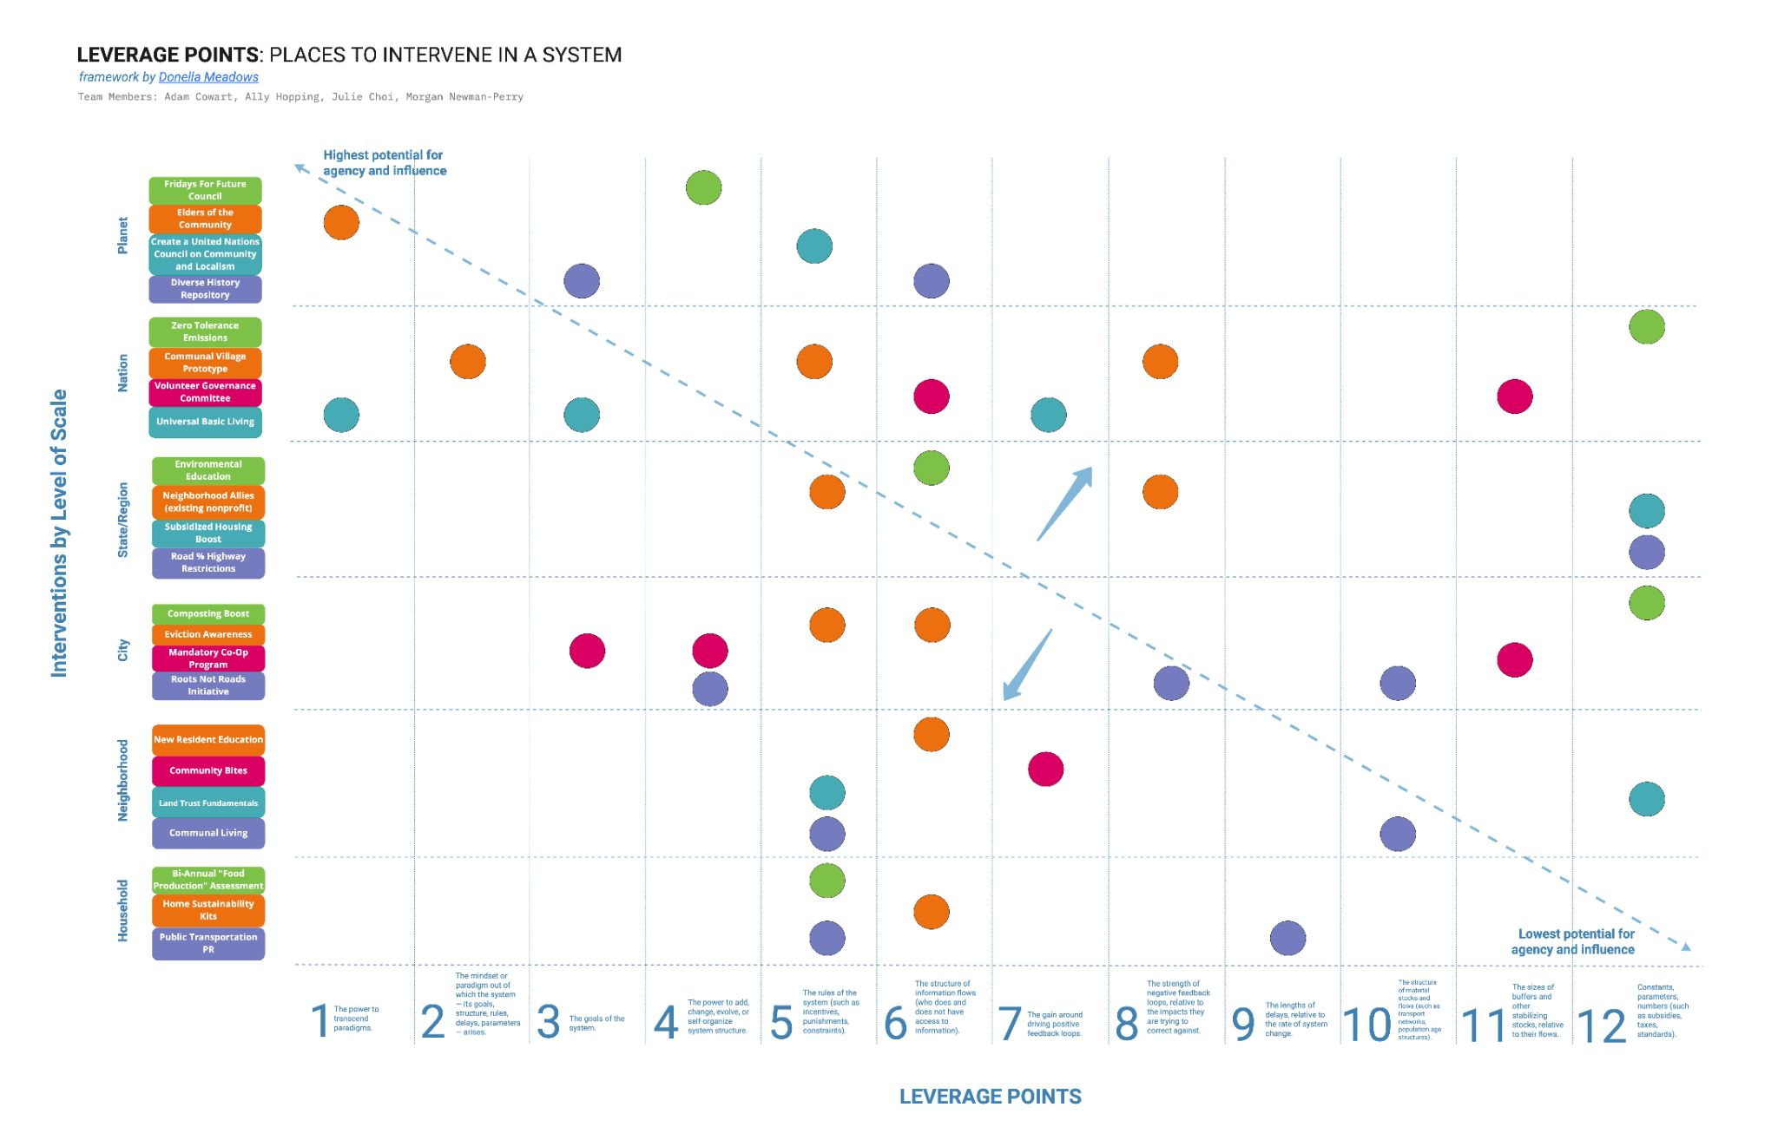
Designing for Transitions
Notes:
Adam

Slide 37
Story/Fictions

Slide 38
SCENARIO
…and…and… and
STORY
… but… but then…
Levels of Abstraction
Degree of Transportation

Slide 39
Design Fiction

Slide 40
“the deliberate use of diegetic prototypes to suspend disbelief about change.”
Bruce Sterling
Notes:
“functional fictions”

Slide 41
“functional fictions”
Notes:
“functional fictions”

Slide 42
Temporal Affordances
Thoughtless Futures
Pluriversality
Deliteralization
Defuturing
Embodiment & Performance

Slide 43
Soooo…………

Slide 44
How might we assess this type of work?

Slide 45
(Possible) Criteria for Speculative Futures
Beginnings
Middles
Ends
Permission
Immediacy
Medium/Message
Internal Consistency
Sensory Vectors
Semiotic Vectors
Keying on Change
Scenario Distinctiveness
Implications
Audience Reception
Action

Slide 46
Beginnings: Permission
Description
Questions to Ask
Permission is the emotional response that kicks in as soon as the experience or artifact is engaged with. It is the “signal” that guides how we should respond. In film, an action movie will begin with a high paced and suspenseful scene; a horror movie starts at night with ominous music. All of these initial interactions give us as an audience “permission” to engage a certain way.
What did this speculative future give me permission to think/feel?
Did it give me permission at all? Or was I left to intuit how I should react?

Slide 47
Beginnings: Immediacy
Description
Questions to Ask
Similar to permission, this considers how quickly a participant is able to engage and immerse themselves within the experience.
How quickly did I “get it”? Did it make sense right away? Did it need to be figured out? How frictionless was the process of figuring out the experience with the future? Was friction deliberately designed into the experience?

Slide 48
Beginnings: Medium/Message
Description
Questions to Ask
Crafting a compelling speculative future often requires the harmonization of the medium and the message. Sending an email from the future, a future in which it is explicitly stated that email no longer exists as a communication method, creates dissonance in terms of user experience.
Does the channel or medium in which the future is conveyed make sense? Is it consistent and aligned with the message? Does the medium and message support each other? Does the message work with the medium, perhaps in a clever way due to technology constraints, or does it work against?

Slide 49
Middles: Internal Consistency
Description
Questions to Ask
Telling a speculative story (in fact, telling any story) requires internal consistencies of the world. Rules. Consider a movie almost everyone has seen – Avengers Endgame. Imagine for a moment, in the penultimate final fight scene, when it looks like all is lost, suddenly Superman and Wonderwoman appear out of nowhere and beat Thanos up, saving the date. As an audience, you would feel cheated. DC Comic characters were not part of this world!
How consistent are the rules of the world? Does the experiential future “cheat” at all? Are there any plot or character “gaps” that are unexplained that need to be?

Slide 50
Middles: Sensory Vectors
Description
Questions to Ask
Experiencing anything draws on the senses. Multi-sensory artifacts and experiences can be rich and layered. Too often we rely on sight at the expense of other senses.
How sophisticated and deliberate have the senses been considered in crafting the experiential future? Does it privilege, balance, or create rich tensions between taste, touch, smell, or hear as well as see? How many senses does the experience engage with? How impactful? Does the intersect of sensory stimuli enrich the experience?

Slide 51
Middles: Semiotic Vectors
Description
Questions to Ask
Speculative futures will necessarily draw on sign processes, the ways in which meaning is interpreted beyond the sign itself. This can be both visual and linguistic. Encounters with the future can often be most impactful when semiotic systems familiar in the present are disrupted somehow in the future.
How intentional and impactful has the semiotic system been designed? What are the signs? The meanings associated with those signs? The coding of meaning? How has the experiential future used semiotic systems in the future to disrupt the present?

Slide 52
Middles: Keying on Change
Description
Questions to Ask
Experiencing the future is in some respects different from experiencing the present. Futures thinking is really about change… how the future is different from the present as a result of change. Change must be evident and manifests in the artifact or experience. We must know we are experiencing the future, rather than just the present or an “alternative present”.
Is there a marked and obvious difference between the present and the future, even if it is subtle or reveals itself slowly over time?

Slide 53
Middles: Scenario Distinctiveness
Description
Questions to Ask
While not always necessary, a speculative future can evoke a clear scenario archetype.
Does the experience or artifact evoke a clear, archetypal scenario? The stuff of a specific future formation? Is the experience a hybrid of discipline, collapse, and transform and, if so, does it “work” or is it trying to do “too much”?

Slide 54
Ends: Implications
Description
Questions to Ask
Not only is the change manifest, but so are the implications of the change or changes. The implications are a) anticipated and obvious at first glance or b) unique and surprising – a “twist” in the plot.
Does the speculative future materialize the implications of one or more change(s)? Does it surface implications in the minds of the audience?

Slide 55
Ends: Audience Reception
Description
Questions to Ask
Speculative futures can be designed to convey a clear message to an audience. Other experiential futures are more abstract, drawing on a more ambiguous and interpretive provocation. Both spectrums can be impactful. What is critical is that the designers of the experiential future take audience reception into consideration, and be deliberate in their intentions. If the designers wish to convey a specific message, then that message should be clear to the audience.
Engage with others on their experience. Was it quite similar? Very different? How wide-ranging was the interpretation of the experience? Was it “clear” to some, but “confusing” to others?

Slide 56
Ends: Action
Description
Questions to Ask
Closing the “experiential gulf” between the future and the present is ultimately meant to trigger some sort of action in the present. Insights gain, implications drawn, compel a certain degree of recalibration in the present.
Does the experience compel any sort of new knowledge (epistemic or ontological) that compels action in the present? Were there any “ah ha” moments? Or did the experiential future fall into the space of passive consumption of entertainment: i.e. “that’s neat – what’s for dinner” category?

Slide 57
Response Room
Contents
Archival elements from class
Contributions from alumni
Distillations from readings
Miro board activities
Contributions
WE WANT YOUR RESPONSES
Reflective/Creative feedback
Making the unconscious, conscious
Looking for emergent response versus technical critique

Slide 58
Epilogue

Slide 59
THIS IS (still)
A CIRCLE
(with words)
Notes:
One word storytelling…

