Slide 1
Timing the Futures: Scenario Archetypes across the Three Horizons
Andy Hines with Denise Worrell, heather Benoit, Lavonne LEong, Adam Cowart, Laura Schlehuber, Mina McBride

Slide 2
Session Agenda
9:30-10:05 The talk
10:05-10:35 Small group discussion
10:35-10:50 Plenary mini-debrief

Slide 3
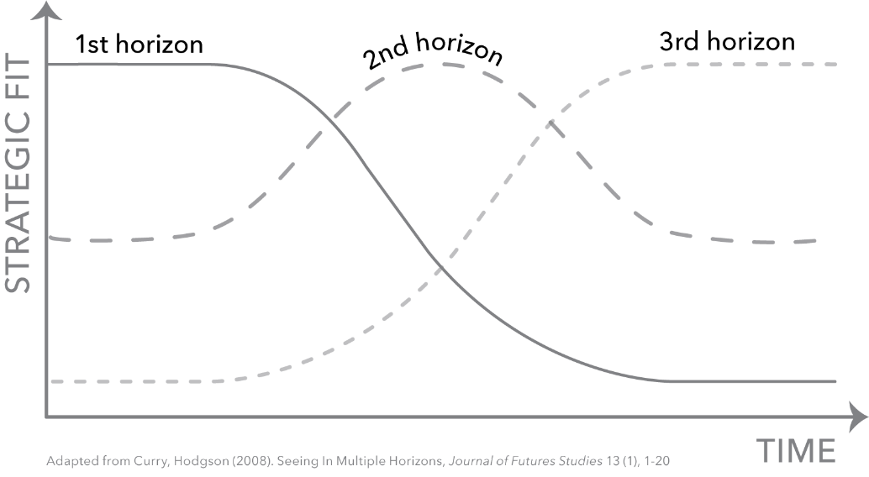
Some Basics: Three Horizons
3

Slide 4
Some Basics: Archetypes
System = current way of doing things within the domain
Transformation The system is discarded in favor of a new one with a new set of rules.
Covid-19 example: A new integrated global public health system for prevention and response
Baseline The system moves forward along its current trajectory. This is the “official future” and usually considered most likely.
New equilibrium The system reaches a balance among competing forces that is significantly different from the current balance.
Covod-19 example:
Vaccine mostly works; ongoing investment in vaccine development
Covid-19 example: Continuous flare-ups and adjust to periodic masks, distancing, and quarantining
Collapse The system falls apart under the weight of “negative” forces.
Covid-19 example: Resulting economic damage drives ongoing civil and political unrest

Slide 5
What are we trying to do?
Test the hypothesis that archetype scenarios within a domain primarily unfold across the Three Horizons in one of two ways:
H1 Baseline > H2 New Equilibrium > H3 Transformation
H1 Baseline > H2 Collapse >H3 Transformation

Slide 6
Why investigate? Proposed pattern becoming more noticeable and useful in our project work
H3
H2
H1

Slide 7
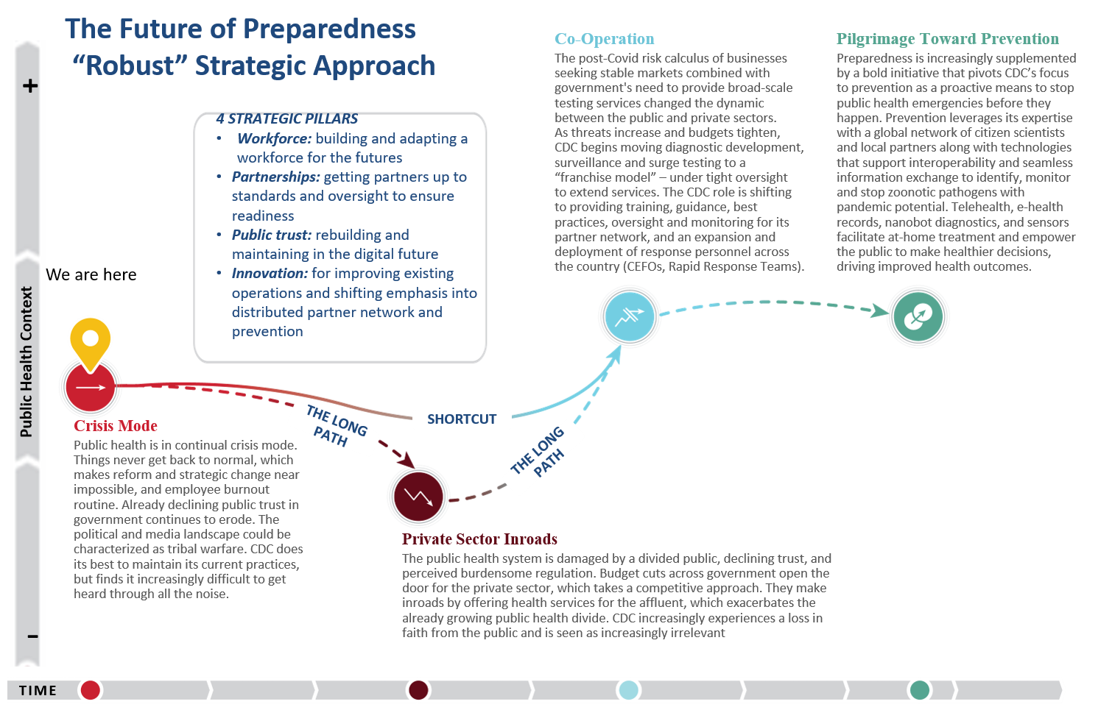
H1
H2
H3
(2021)

Slide 8
Knowledge Work Futures 2007
Let’s see if any of older sets follow the pattern … et voila!
Personalized Professions (Transformation)
H3
Successful new organizational and business models emerge around knowledge work that frees workers to personalize their contributions. Work is largely driven by personal interest. All workers are knowledge workers.
.
H2
Socially-Centric Work
(New Equilibrium)
Digitization and social networks create new collaboration opportunities, new roles and relationships, as insiders, freelancers, and even customers routinely work together.
H1
Virtual Teams Collaborating
(Baseline)
Work is increasingly virtual, but progress is evolutionary rather than revolutionary. Work in 2020 is far more decentralized and different in many respects, but the transition is manageable.
Back to Basics (Collapse)
Innovative approaches to knowledge work are put on the back burner as tough economic times and high-profile security breaches call new modes of work into question.

Slide 9
And from the Literature Search: Wack and Shell

Slide 10
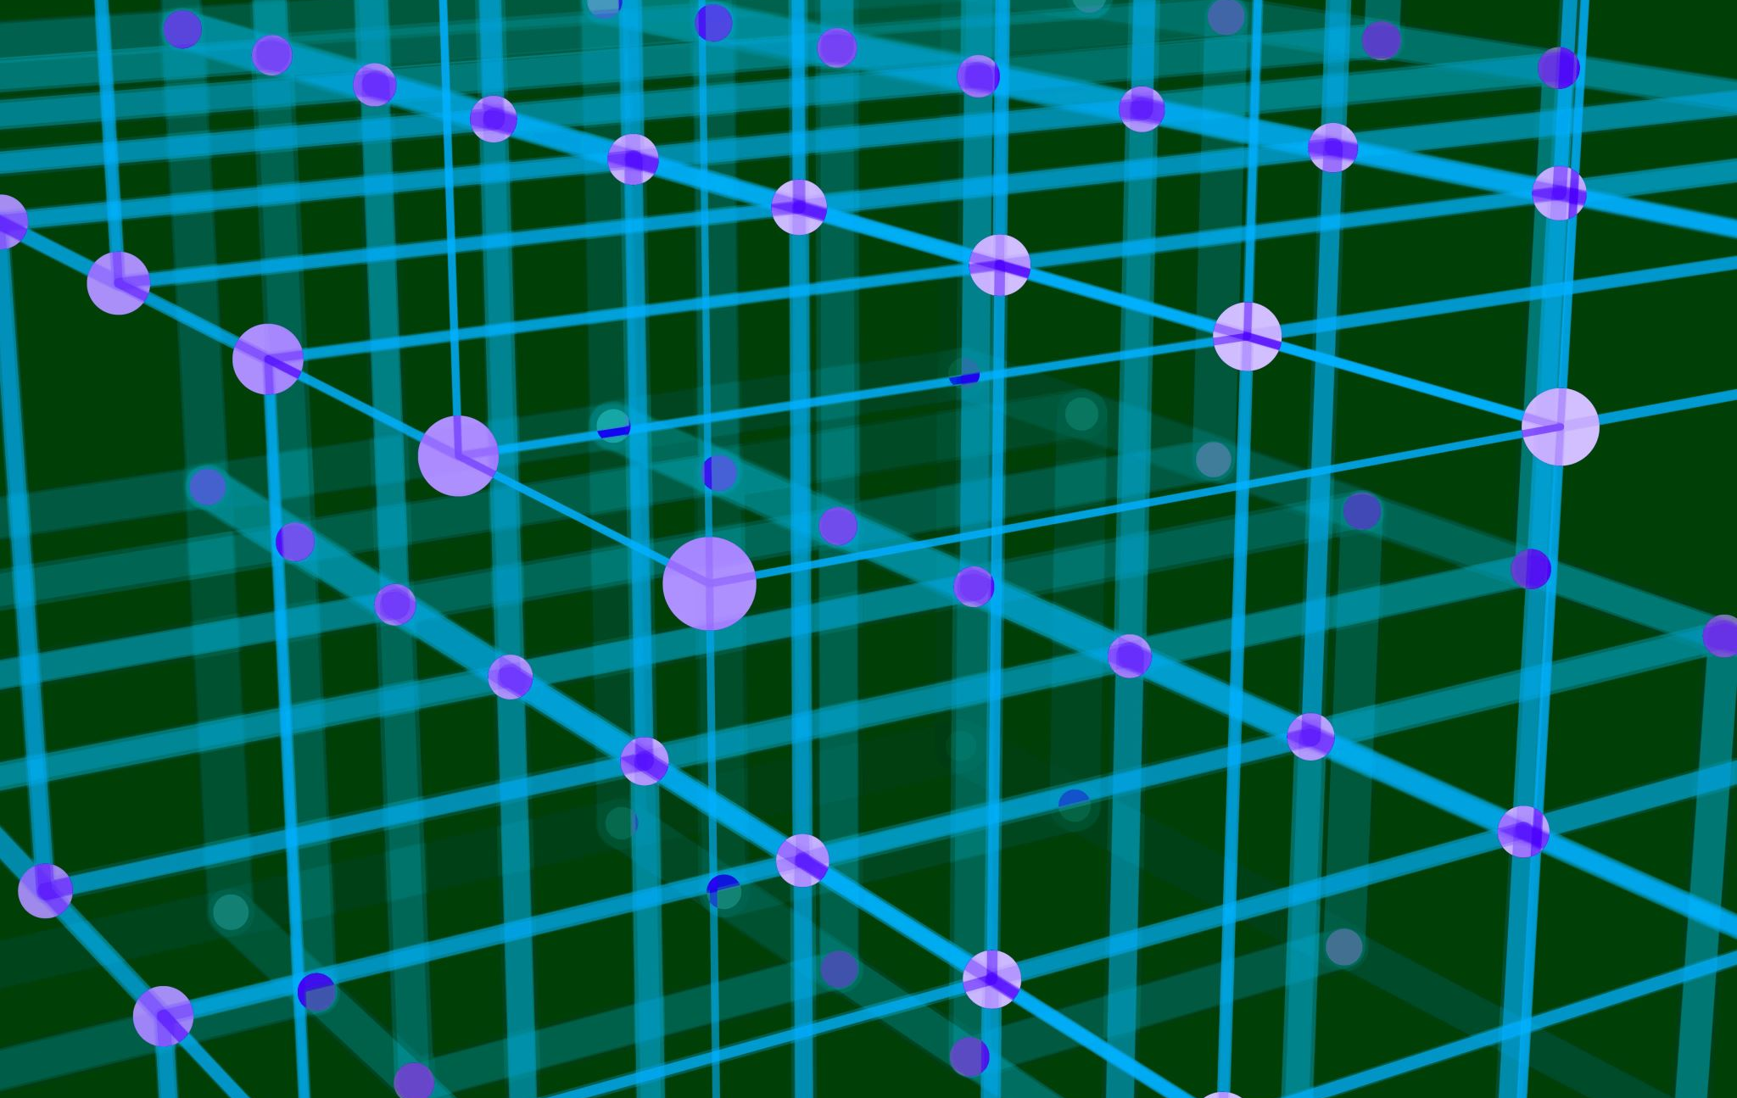
Method

Slide 11
Some Basics > ASSUMPTION: All scenarios “start” in the present and become more (or less) influential over time
H1
H2
H3
New equilibrium
Transformation ONE
OR
OR
Baseline
Collapse
Transformation TWO
Time
Baseline weakens, Collapse & NE strengthen and/or weak; transformation strengthens

Slide 12
The Methodology
Find
Find domain(s) with historical set of scenarios
Fit
Fit the scenarios to archetypes – to the extent feasible
Map
Map the scenarios to the “historic” Three horizons of the domain over time – to the extent feasible

Slide 13
Searching for Scenario Sets
Open search
Searching foresight journals
Archive or platform sites
Foresight teaching & personal projects
a general web search was conducted for publicly available historical scenarios
five foresight journals were searched: Futures, Foresight, TF&SC, World Futures, Journal of Futures Studies
For example, the Millennium Project work created a bibliography of scenarios
Hines’ professional futurist work involving dozens of projects he led over the last thirty year and including U of Houston project work
Hines has been gathering scenarios sets for teaching purposes

Slide 14
Archetype Fit Table Example
Chemical Industry (Dow Chemical) 2004- 2020 | Archetype | Scenario fit to Archetype (Hi, Med, Lo)
Conventional Wisdom Described in 24 statements based on research and interviews with leadership | Baseline/Collapse | Hi
Hydrocarbons Rule Caspian oil comes online, creating vast new sources of supply Russia and Central Asian firms develop industry, focus on exports to Europe first Major US and European players can no longer compete in Europe, losing market share in N. America By 2020, the main production centers for chemicals are in the Middle East, Russia, and Central Asia | New Equilibrium | Hi
Emerging Markets Rewrite the Rules Asian players become skilled at reverse-engineering specialty chemicals and exporting cheaper versions Asian players gradually achieve scale required to compete on price in commodity products In serving local markets, Asian players create new cost-effective, innovative solutions that become successful exports to the West By 2020, Asian players threaten to dominate global growth | New Equilibrium | Hi
The Next Envelope Emerging technologies begin to converge: exciting new findings at intersections of nanotech, biotech, infotech, and chemistry Rising environmental movement and regulations force attention on green solutions Major breakthroughs in energy and alternative feedstocks reduces dependency on hydrocarbons By 2020, the chemicals industry is transformed into one of the most innovative areas of science and business, attracting talent and capital | Transformation | Hi

Slide 15
Archetypes over Time For the full set of 78 sets, only 10% reached transformation … yikes! So, we looked at those that “reached their timeframe” and: 15% in baseline 31% in collapse 31% in NE 23% in transformation
Table x: Scenario Pathways
 | Scenario Set | Timeframe | Pathway
1 | Mont Fleur (Shell for S. Africa) | 1992-2002 | B>NE>T
2 | Higher Education: The California Case (Ogilvy/GBN) | 1993-2008 | B>NE
3 | Four Scenarios of State Government Services and Regulation in the Year 2010 (Bonnett and Olson) | 1994–2010 | B>NE
4 | Your Health in 2010 (IAF) | 1996-2010 | B > C
5 | Airforce 2025 | 1996-2025 | B>C/NE>T
6 | Virtual University Scenarios (Fred Hurst) | 1998-???? | B>NE
7 | Four Futures for Hawaii | 1999-2030 | B>C>EARLY NE
8 | Environmental Futures (SPRU) | 1998-2040 | B>C
9 | IAF Genomics | 2000-2015 | B>NE
10 | Biotechnology (WBCSD) | 2000-2050 | B
11 | Great Transition (Global Scenario Group) | 2002-2050? | B
12 | Chemical Industry (Dow Chemical) | 2004-2020 | B/C >NE>early T
13 | Mapping the Global Future (NIC) | 2004–2020 | B>C/NE
14 | Sustainable Urban Water Management (Makropoulous et al) | 2005-2020 | B>C
15 | US Families 2025 (Montgomery/UHCL) | 2005-2025 | B>
16 | Global Energy Scenarios (Millennium Project) | 2006-2020 | B>C
17 | Marine Ecosystems (DEFRA) | 2006-2036 | B>C
18 | Agriculture (Dow Agrosciences) | 2007-2017 | B>NE>early T
19 | Knowledge Work (Social Technologies) | 2007-2020 | B>NE>T
20 | Our Biopolitical Future (WorldWatch) | 2007-2021 | B>
21 | Mobility (Nissan) | 2008-2018 | B>NE
22 | Texas DOT Scenarios | 2008-2040 | B>NE
23 | Lodging (InterContinental Hotel Group) | 2009-2020 | B>early C
24 | Road to 2020: Scenarios for World in Crisis (World Bank) | 2009-2020 | B > T
25 | American Classroom: Beyond the Four Walls | 2009-2025 | B>NE
26 | The Century Ahead (Tellus Institute) | 2009-2025 | B>C
27 | A Post-Carbon Aviation Future (Kivits et al for Airport Metroplis Australia) | 2009-2059 | B>some C
28 | Oxford Future of City Scenarios (Noah Raford) | 2010-???? | B>
29 | The Carbon Economy (IFTF) | 2010-2020 | B > C
30 | Molecular Identity (IFTF) | 2010-2020 | B >
31 | Water Ecology (IFTF) | 2010-2020 | B > C
32 | Adaptive Power (IFTF) | 2010-2020 | B > C
33 | Cities in Transition (IFTF) | 2010-2020 | B>
34 | Africa 2010-2020 (Curry et al) | 2010-2020 | B > NE
35 | CEP Agriculture Energy 2030 Synthesis | 2010-2030 | B>EARLY NE 2
36 | Technology and International Development (GBN/Rockefeller) | 2010-2030 | B>NE
37 | Scenarios based on sustainability discourses: Crivits et al., for Belgium) | 2010-2050 | B>some NE
38 | Changes to the Land (Harvard University) | 2010-2060 | B>C
39 | Mythic Images of Future Cities (Frewen) | 2011-2025 | B>
40 | Chemical Industry Context (Arizona Chemical) | 2011-2021 | B>NE
41 | Credit Unions (Filene) | 2011-2021 | B>NE
42 | The Evolving Internet (Cisco/GBN) | 2011-2025 | B >NE> T
43 | Scenarios for the Mediterranean Region (World Economic Forum) | 2011-2030 | B>C
44 | Families to 2030 (OECD) | 2011-2030 | B>C/NE
45 | Future of Vulnerability 2030 (IAF for Robert Wood Johnson Foundation) | 2011-2030 | B>C
46 | Global Megacrisis (Halal and Marien) | 2011-2033 | B > C
47 | Library Futures (Inayatullah | 2011-2060 | B/C>NE
48 | Some future scenarios for renewable energy (Sadorsky) | 2011-2100 | B>
49 | Broadband Demand (Cable Labs) | 2012-2022 | B>T
50 | Primary Care 2025 | 2012-2025 | B>EARLY C
51 | Building Resilience in the Transition to a Digital Economy and a Networked Society (Policy Horizons Canada) | 2012-2025 | B>C
52 | Alternative future scenarios for South Korea in 2030 (Son) | 2012-2030 | B>
53 | Health and Health Care in 2032 Scenarios | 2012-2032 | B>C
54 | Futurevision Scenarios for the World in 2040 (Watson and O. Freeman) | 2012-2040 | B>NE
55 | Energy Futures for Canada | 2012-2050 | B/C>
56 | Delivering Tomorrow: Logistics 2050 (ZPunkt for DHL) | 2012-2050 | B>NE
57 | Low-Carbon Futures and Sustainable Lifestyles (Neuvonen et al) | 2012-2050 | B>
58 | Future of the courts (Tonn et al) | 2012-2050 | B>
59 | K-12 Teaching: Decade of Disruption | 2014-2024 | B>NE
60 | The Future of Asia: Forces of Change and Potential Surprises (Policy Horizons Canada) | 2014-2024 | B>NE
61 | Imaging BRICs (BRICs Magazine) | 2014-2029 | B>NE
62 | Public Health 2030 | 2014-2030 | B>EARLY C
63 | Arab futures: Three Scenarios for 2025 (Institute for Security Studies) | 2015-2025 | B>
64 | Technolife of Romeo and Juliet (Hiltunen) | 2015-2035 | B>
65 | Automated Vehicles (Tenn DoT) | 2016-2030 | B>NE
66 | Residency & Foreigners Affairs (GDRFA Dubai) | 2016–2030 | B/T> C
67 | Canada in a Changing Global Energy Landscape (Policy Horizons Canada) | 2016-2030 | B>
68 | Forest Futures (US Forest Service) | 2017-2035 | B
69 | Work (NASA Langley) | 2017-2050 | B
70 | Sustainable Waste Management (CP1 ) | 2018-2028 | B> early C
71 | Built Environment (CII) | 2018-2028 | B
72 | IAF: Human progress and Human Services 2035 | 2018-2035 | B>
73 | Circular Economy (CP 2) | 2019-2029 | B
74 | Changing Demand for Higher Ed (Rowan) | 2019-2030 | B
75 | Veterinary Assessment (ICVA) | 2020-2030 | B
76 | PH Evidence (Govt 1) | 2020-2030 | B/C
77 | Public Health Emergency Lab Preparedness | 2020-2030 | B/C
78 | NC Communities (Local Govt FCU) | 2020-2040 | B/C
Table x: Scenario Pathways
 | Scenario Set | Timeframe | Pathway
1 | Mont Fleur (Shell for S. Africa) | 1992-2002 | B>NE>T
2 | Higher Education: The California Case (Ogilvy/GBN) | 1993-2008 | B>NE
3 | Four Scenarios of State Government Services and Regulation in the Year 2010 (Bonnett and Olson) | 1994–2010 | B>NE

Slide 16
Learnings

Slide 17
Updating our Scenario Archetype Technique: The HAT
H1
H2
H3
Transformation ONE
New equilibrium
Baseline
Collapse
The HAT
Houston
Archetype
Technique
Transformation TWO
More Emphasis on Transformation!

Slide 18
Why does change appear to be slower than we think?
Why are so many domains stuck in the baseline?
The power of those with the most at stake in the baseline is exercised to keep the baseline where it is. Part of it is simple power. Part of it is sunk-costs, e.g., what we see now with the fossil fuel industry.
PEREZ: H1 is really good at maintaining itself
Is there a “New Equilibrium Loop?
a domain does a new equilibrium, retreats, and does it again, and delays or avoids transformation
Raeworth: collapse is rarely beneficial
Does lack of imagination explain lack of transformation ?
Are we being “too tough” and looking for total transformation? Could there be a partial transformation, e.g., sustainability in pockets like San Francisco

Slide 19
Identifying Horizon Shifts
1. Look at the rules
2. Monitor the conversation
3. Identify the chasm and the mountain
4. Identify scenario-specific indicators:
5. CLA tells you what the shift looks like when it’s “done”
6. STP (sociotechnical transition pathways) as part of MLP (multi-level perspectives)

Slide 20
Horizon Shifts: Look at the Rules
The current rules of the domain are the baseline. As the baseline starts to degrade, we start seeing a shift in the rules.
New Equilibrium > CHANGING RULES
The system reaches a balance among competing forces that is significantly different from the current balance.
Transformation > NEW RULES
The system is discarded in favor of a new one with a new set of rules..
Collapse > NO RULES
The system falls apart under the weight of “negative” forces.
Baseline > SAME RULES
The system moves forward along its current trajectory. This is the “official future” and usually considered most likely.
H1
H2
H3

Slide 21
Horizon Shifts: Monitor the Conversation
Systems thinking expert Donella Meadows came up with the idea of “leverage points” in a system or domain. The easiest interventions don’t really move the needle. The hardest thing to do, but the most effective, is to change the mindset. When people are talking about the domain, is the conversation focused on metrics, structure, or mindset?
New Equilibrium
Transformation
Focus on the Structure
“Change the process”
E.g., universal health care
Focus on the Paradigm
“Change the mindset”
E.g., Green New Deal or UBI
Baseline
Collapse
Focus on the Metrics
“Change the numbers”
E.g., decrease tax rates
Easy to do
Not much impact
Harder to do
Some impact
Hardest to do
Greatest impact
H1
H2
H3

Slide 22
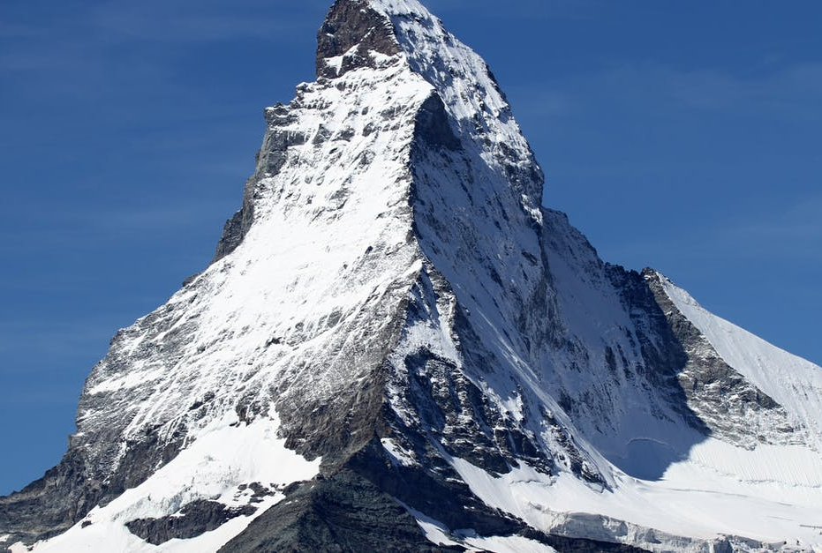
Horizon Shifts: Identify the Chasm and the Mountain
Transformative ideas start as weak signals. As the gain strength, they must meet two tests: the first test is the jumping the chasm from weak signal to disruptive potential; the second test is climbing the mountain from disruption to new system.
Mountain questions
Will: Do we have the will to meet the inevitable pushback?
Resources: Do we have the social, economic, and political resources to see it through?
The Transformation Journey
Chasm questions
Can we technically do it?
Do people want it?
Is it an easy story to tell?
H1
H2
H3

Slide 23
Horizon Shifts: Monitoring: Identify Indicators and Track

Slide 24
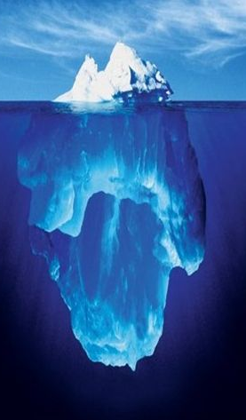
Horizon Shifts: What it Looks Like on the Other Side
Causal Layered Analysis is a tool that futurists use to look at the different levels of a topic or domain.
Transformation 1
1. Disney to invest $33B
2. Streaming (subscribers)
3. Modern
4. Quality is King
1. Create Your Own Reality Show In The Sims
2. AR (co-creators)
3. Postmodern/ Integral
4. Integration
Baseline
Transformation 2
Collapse
KEY
1. Headlines
2. The System & users
3. Worldviews
4. Metaphors
H1
H2
H3

Slide 25
Small Group Work

Slide 26
Discussion Questions & Report Back
Break into five teams of six each
Discussion Questions
Groups discuss example of an actual or proposed transformation to work on.
How does your group define transformation?
Why do you think transformation is generally so difficult?
What might we futurists do to make it easier for transformation in the future?
Report Back on “Juiciest” idea
We DO NOT have time for a recap of everything you talked about
Each team has 3 minutes to report back on your “juiciest” insights

Slide 27
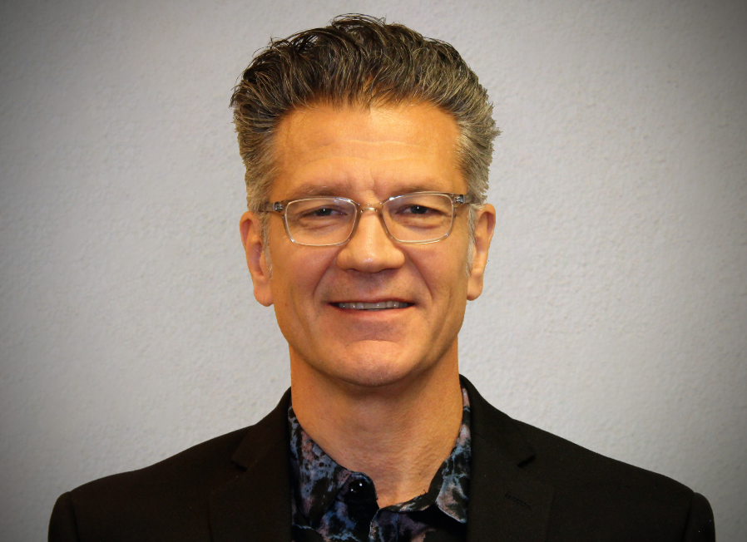
Contact Info
Dr. Andy Hines
U of Houston Foresight
Program Coordinator
ahines@uh.edu
832 367 5575 www.andyhinesight.com
27

Slide 28
A Few Observations
We need more historical scenario sets
Of the 78 scenario sets we used, just over a third (25) had “reached” their projected time horizons, i.e., the scenario set had a timeframe that ended before the year 2022.
NE the more common route transformation
It was interesting to note that NE was the more common pathway to transformation than via collapse. That seems to go against the popular perception that crisis is necessary for significant change.
We’re often stuck in the middle
When only looking at those set reaching their timeframe, roughly one-third were in the H1 baseline (12%) or H3 transformation (20%). That means two-thirds were in H2 collapse or new equilibrium.

