Slide 1

Foresight program
Spring 2022

Slide 2
The Numbers
Fall 2021 90 students
Spring 2022 85 students

Slide 3
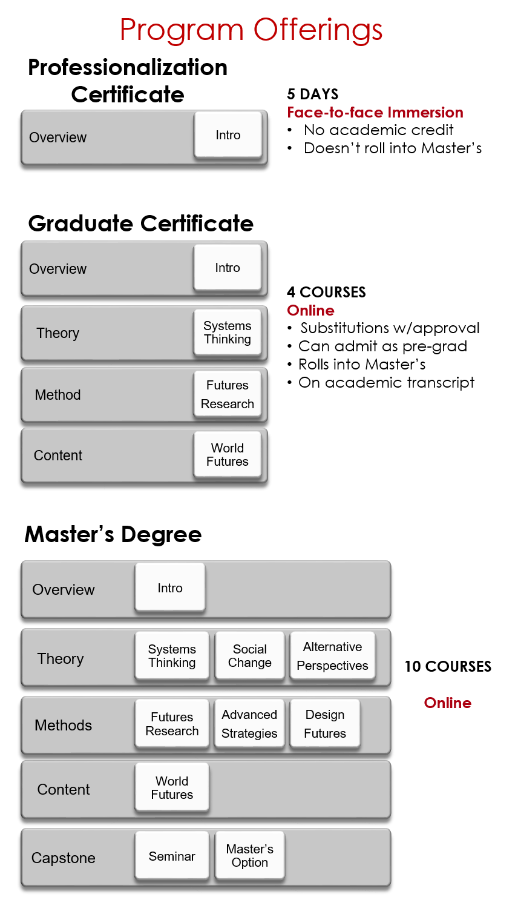


Slide 4
Courses
Course Sequence 2021
Spring 2021
Mon | Fore 6311: Intro to Foresight (Woodgate)
Mon | Elective: FORE 6355 Alternative Perspectives (Cowart)
Tue | FORE 6371: World Futures [Hines]
Wed | FORE 6333: Systems Thinking [Schultz]
Thur | FORE 6319: Proseminar in Foresight [Hines]
Summer 2021
Mon | FORE 6333: Systems Thinking [Schultz]
Tue | FORE 6397: Selected Topics, Communicating the Future [Schlehuber]
Fall 2021
Mon | FORE 6311: Introduction to Foresight [Schultz)
Tues | FORE 6331: Social Change [Frewen]
Wed | FORE 6371: World Futures Research [TBD]
Wed | FORE 6351: Futures Research [Hines]
Thurs | HDCS 6331: Advanced Strategies for Futures Planning [Hines]

Slide 5
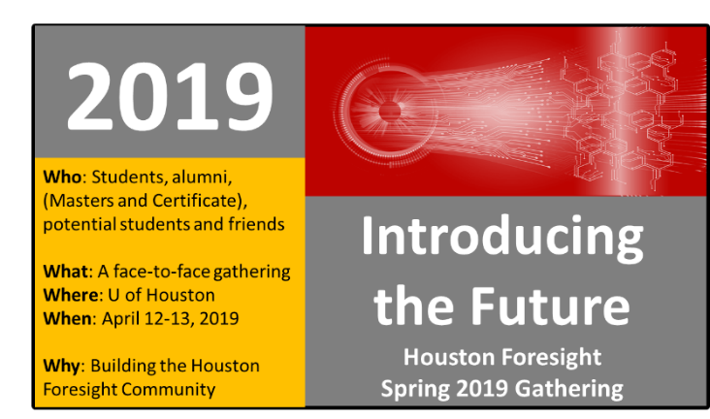

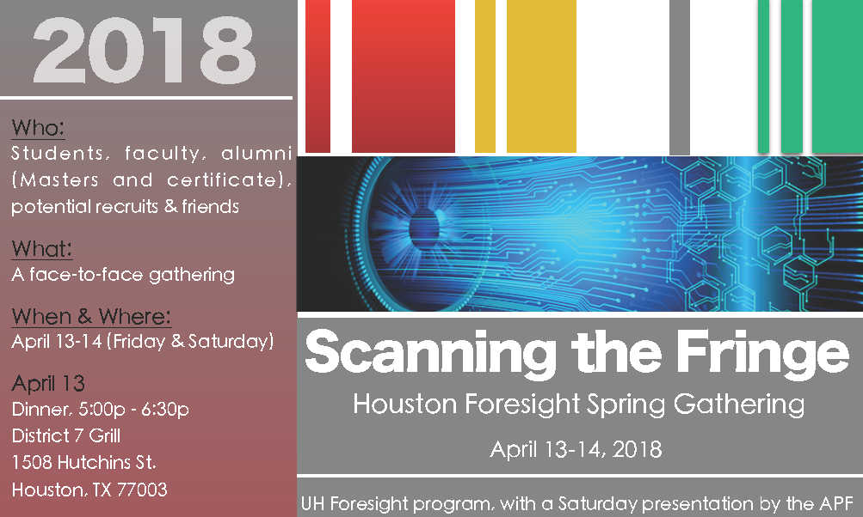



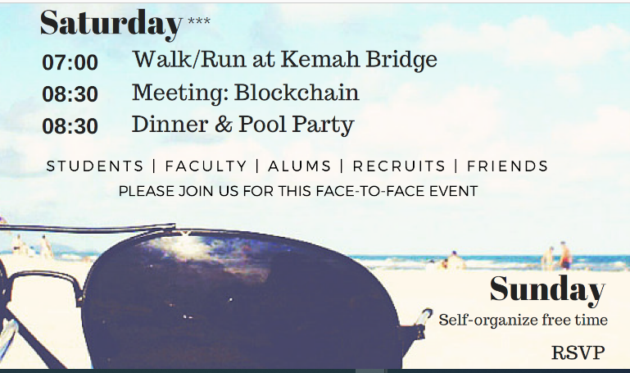

Spring Gatherings

Slide 6
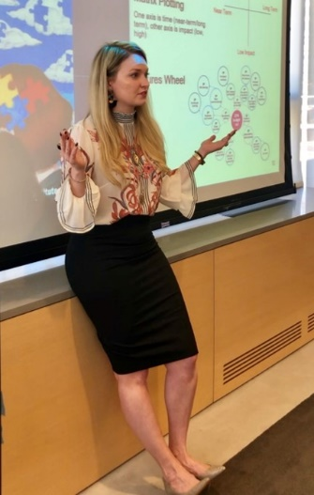
Summer Elective 2021 : Communicating the Future
Previous
Science Fiction as Futures, Tim Morgan
Data Mining, Anne Boysen
Building Capacity for Transformation, Cecily Sommers
Design Futures, Cindy Frewen
Images of the Future, Wendy Schultz
Technology Forecasting, Peter Bishop
Women as Builders of the Future, Terry Grim
Future of Biotechnology Peter Bishop
Future of Climate Change, Peter Bishop
Summer 2021
Communicating the Future,
Laura Schlehbuber

Slide 7
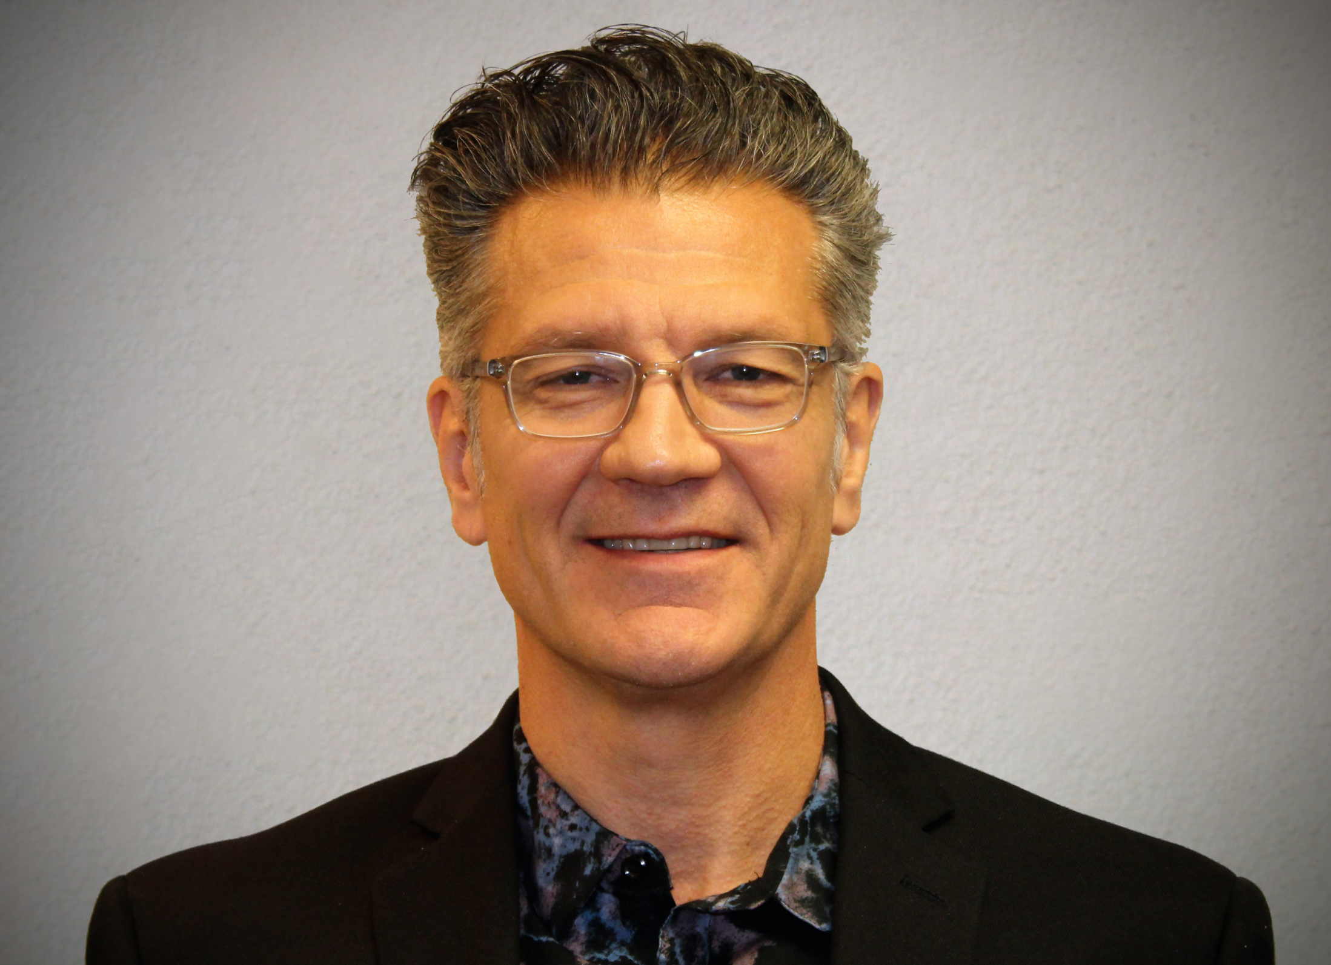

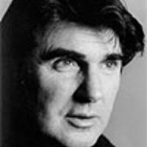
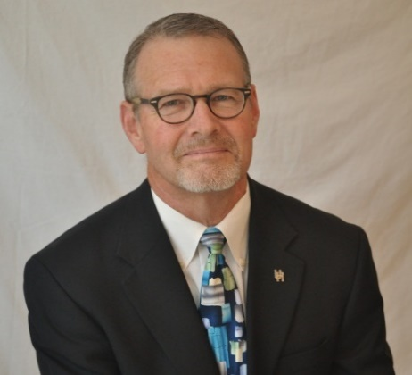
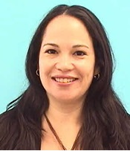
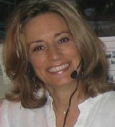
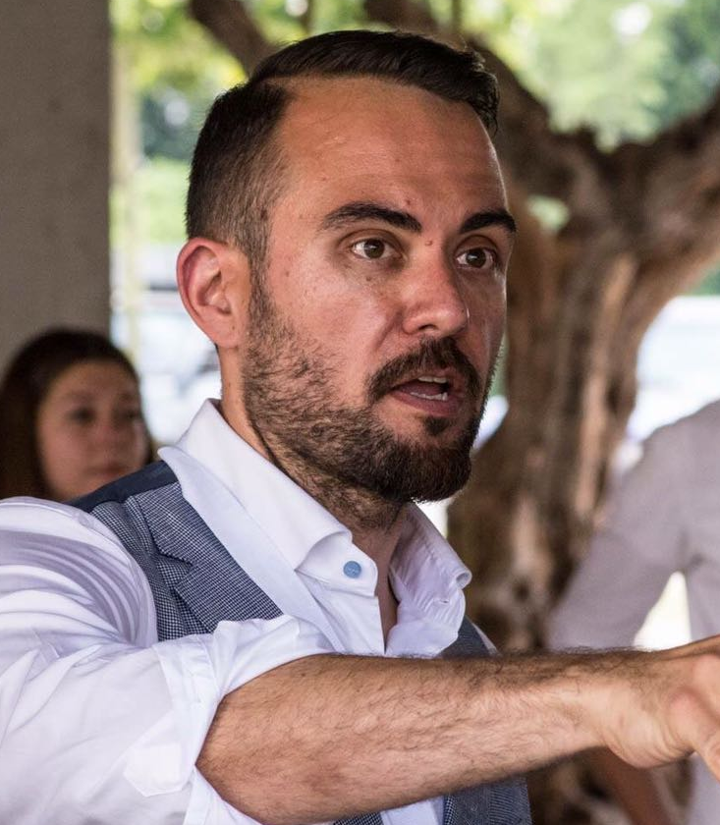
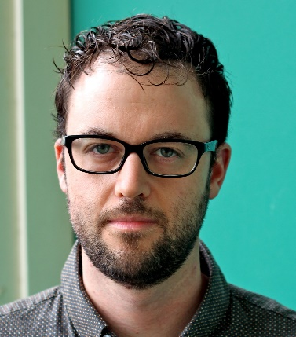
Faculty
Graduate
Undergrad

Slide 8
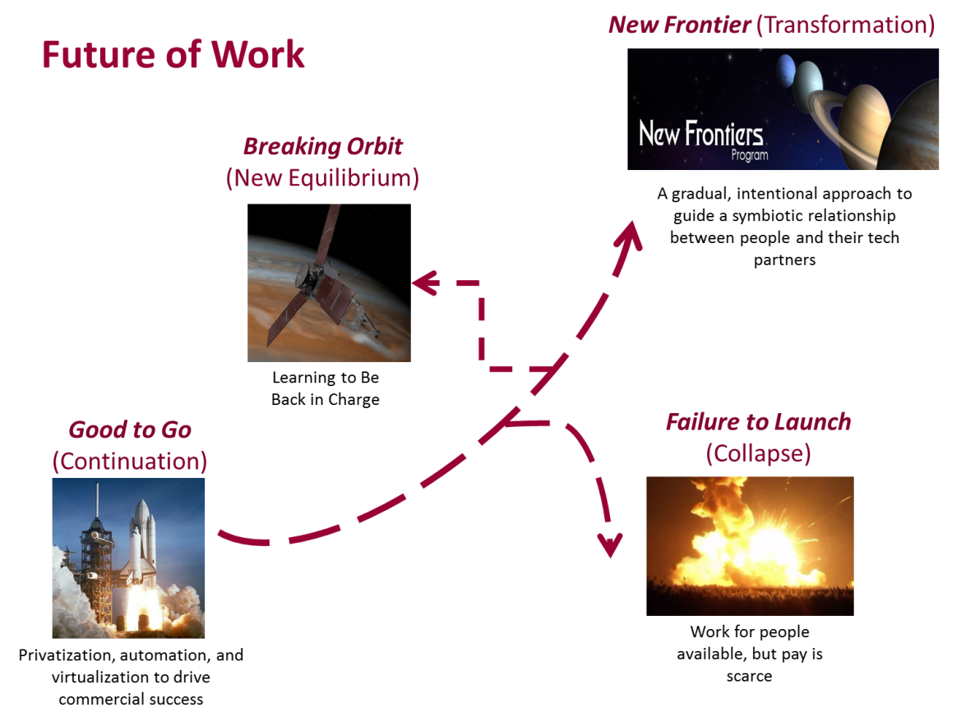
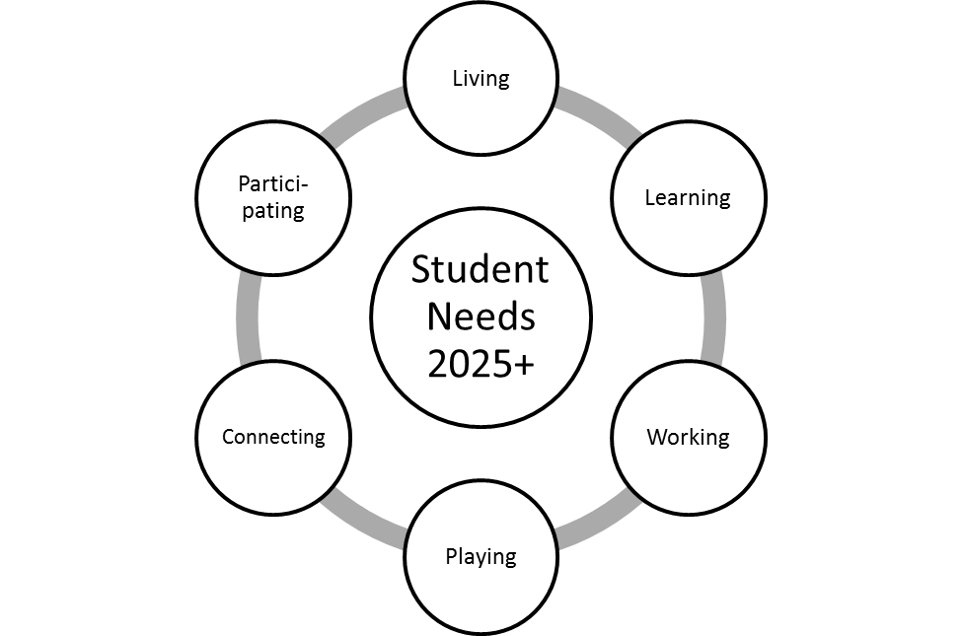
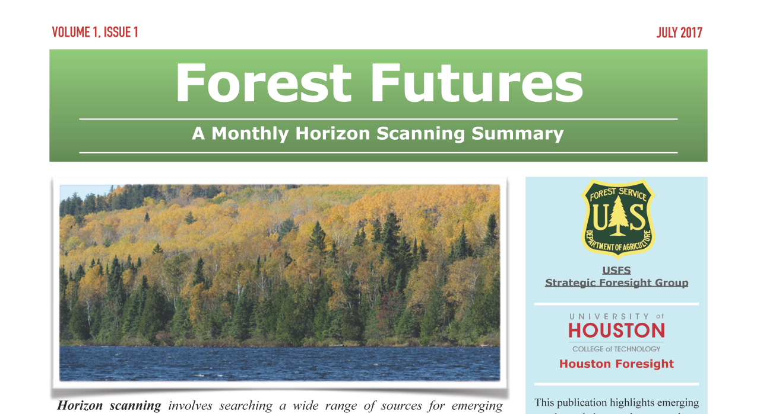
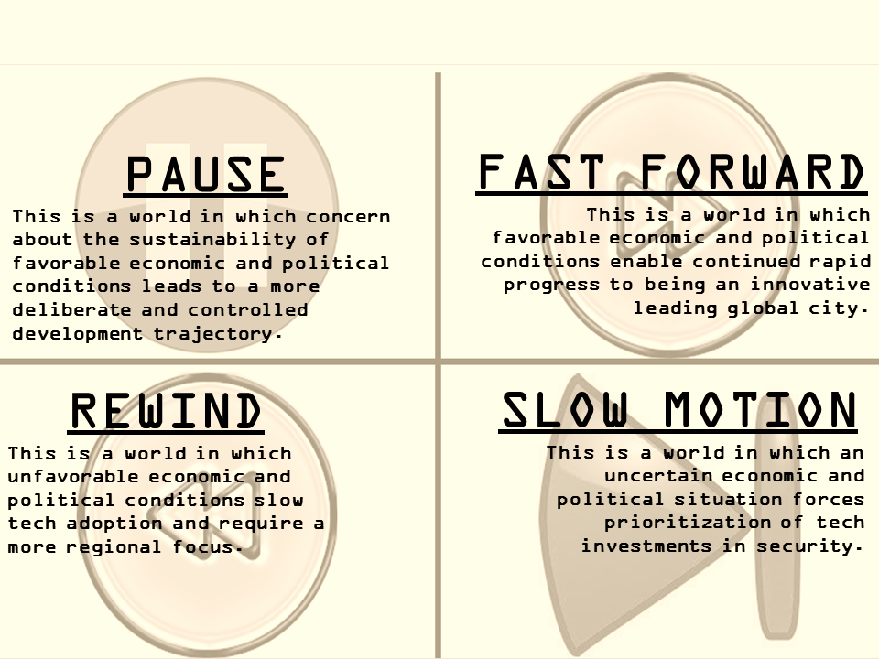
Research Projects (1)

Slide 9




Research Projects (2)
DONE
Future Role of Assessment in the Veterinary Profession
Future of Joy-Led Eating Experiences
Future of NC Communities 2040
Future of Pet Care
In progress
Strategic Foresight Training for CDC (Centers for Disease Control & Prevention)
Future of the Built Environment

Slide 10


































Some of our Graduates

Slide 11
Contact Info
Andy Hines
Associate Professor &
Program Coordinator, Foresight
University of Houston
ahines@uh.edu
www.houstonforesight.org

