Slide 1
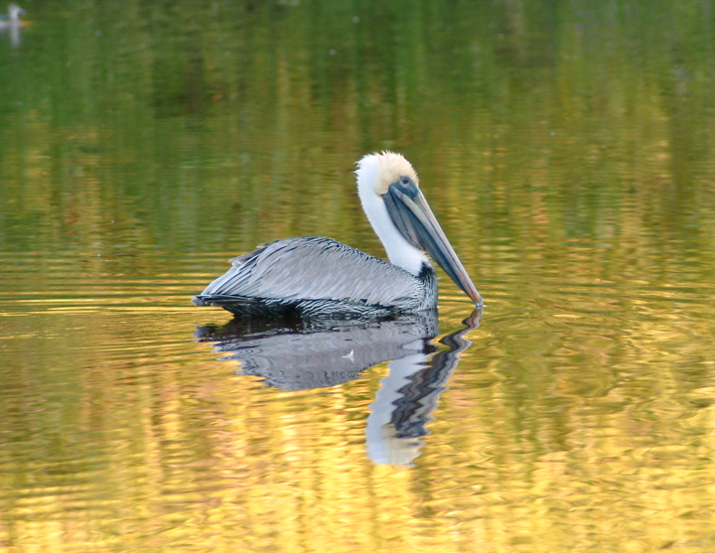

Slide 2
Notes:
We Are Doomed: Who Said This
https://www.polleverywhere.com/multiple_choice_polls/HctFzSwrZZ4ikHA1m3ehf

Slide 3
Veterinary Medicine: Are the Best Days Behind Us
Karen Rosenthal, DVM, MS, EC-FI’17 Professor, Exotic Animal Medicine
LIU-CVM
Notes:
Why does vet med need foresight
How can you introduce foresight to vet med
Is it too late
Will they listen

Slide 4
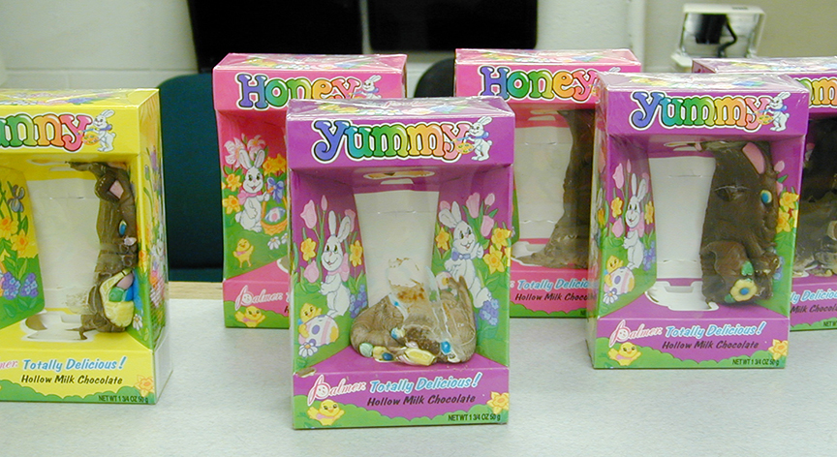
Veterinary Medicine:
Can Foresight Save this Patient

Slide 5
Why Veterinary Medicine Needs a Vision of a Better Future
Corporatization of the profession
Student debt
Gulf between prices and owner’s pocketbook
Suicide rates
Lack of diversity
Notes:
35B profit at MARS- more from pets than candy
2017 U.S. veterinary graduates owed $403 million in student loans
The $15000 rabbit
2015 CDC study that found 1 in 6 veterinarians have considered suicide
Suicide rate 3.5 times national average
Whitest profession in America

Slide 6
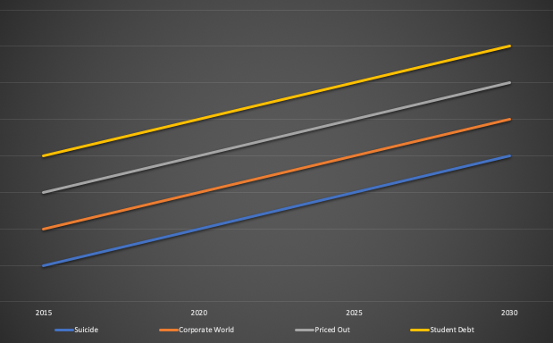
Trends in Veterinary Medicine
Notes:
Veterinarians see the baseline as their future. Who wouldn’t be pessimistic if this were your future is going to lead to collapse. Clearly our job is to convince the members of this profession the baseline does not have to be their future and may not be their future. Shows an implicit bias towards not planning for the future. As futurists, we need to show them the trends may not continue and if it does, what actions can they do that this does not lead to collapse

Slide 7
How to Introduce Foresight to Veterinary Medicine
Articles
Conferences
Associations
Veterinary Schools

Slide 8
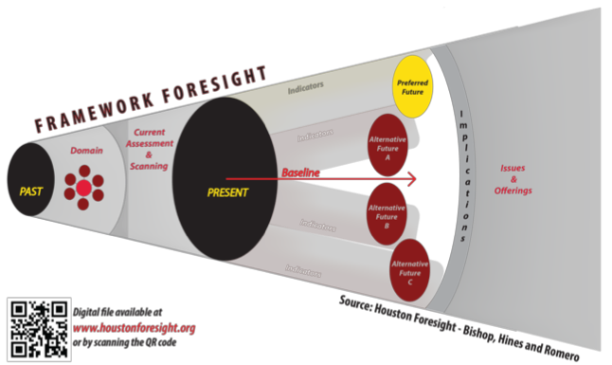
Houston FORESIGHT: Preparing Professional Futurists

Slide 9
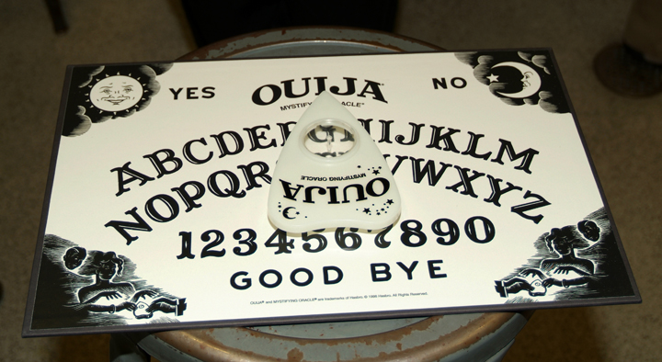
What Foresight is Not
Subjective
Short term planning

Slide 10
Veterinarians
You are all futurists
“How long does he have”
“When will she get better”
“When does he stop feather picking”
How do you answer those questions

Slide 11
Veterinarians as Futurists
SOAP is a foresight exercise
Ask a question
Collect data
Give the owner an option for plans based on the future they want

Slide 12
SOAP’s
Foresight
Frame your question
Research the history
Examine the current state
Use data to assess the health factors
Communicate to client the patient’s future
Plan based on desired future for patient
Frame a question
Examine history
Examine the current state
Assess trends and drivers of change
Communicate to client the scenarios of the future
Develop a plan based on scenarios

Slide 13
Will Veterinarians Listen
Over 300 strategic plans by stakeholders in the last five years
Foresight projects
How do you get a profession to listen

Slide 14
Is it Too Late?
Need to get a message out
Many stakeholders to reach
Start with students, associations, academics

Slide 15
Foresight
“Any useful statement about the futures should appear to be ridiculous”- Jim Dator

